Slide 1
Breast Cancer Risk Prediction Using Neural Networks
John Sum
Institute of Technology Management National Chung Hsing University

Slide 2
Outlines
Introduction
Biomarkers
Multilayer perceptron
Preliminary results

Slide 3
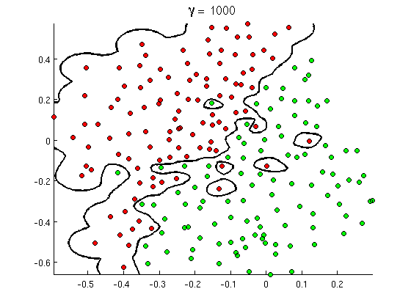
Introduction

Slide 4
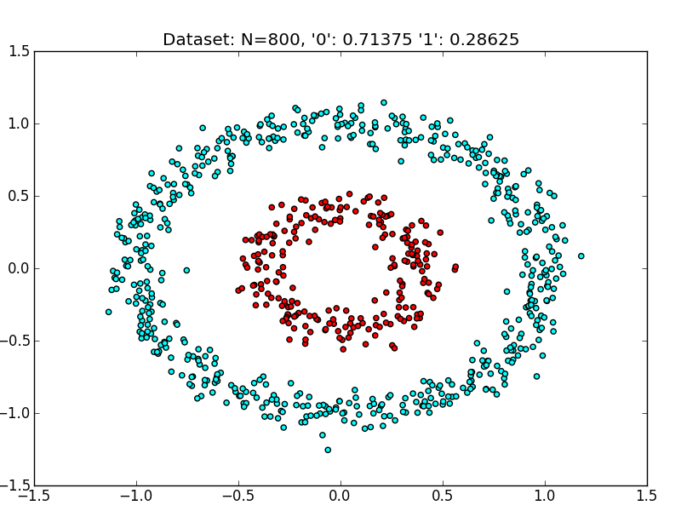
Introduction

Slide 5
Introduction

Slide 6
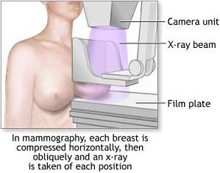
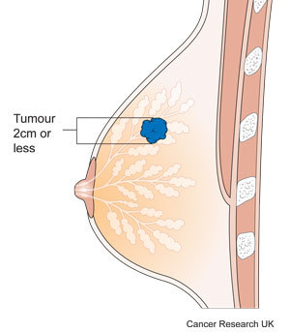
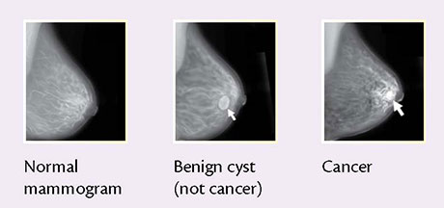
Mammogram

Slide 8
Biomarkers
Potential mutagen/carcinogen
Reactive metabolites
DNA adducts
Protein adducts
Serum Albumin
Hemoglobin
Repair
Mutation
All of them can be used for breast cancer risk prediction.
Inherited disorders
Cancer

Slide 9
Serum Proteins

Slide 10
Serum Proteins
J.L. Jesneck et al, Do serum biomarkers really measure breast cancer, BMC Cancer, Vol.9(1), 164-2009.

Slide 11
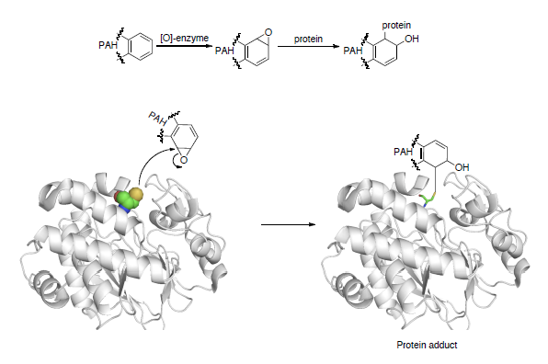
Hemoglobin and Albumin Adducts
http://www.intechopen.com/source/html/41885/media/image11.png

Slide 12
Hemoglobin and Albumin Adducts
Rappaport SM, Li H, Grigoryan H, Funk WE, Williams ER (2012). Adductomics: Characterizing exposures to reactive electrophiles, Toxicology Letters, 213(1) 83-90.
Hemoglobin
  Approximately 150 mg per ml of blood
  Half-life is around 120 days
Albumin
  Approximately 30 mg per ml of blood
  Half-life is around 20 days

Slide 13
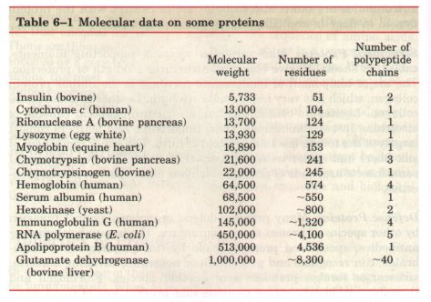
Hemoglobin and Albumin Adducts
Dalton (Da): 1/12 of the mass of the nucleus of carbon 12.

Slide 14
TNM Staging System
Primary Tumor (T)
  TX: Primary tumor cannot be evaluated
  T0: No evidence of primary tumor
  Tis: Carcinoma in situ T1, T2, T3, T4: Size and/or extent of the primary tumor
Regional Lymph Nodes (N)
  NX: Regional lymph nodes cannot be evaluated
  N0: No regional lymph node involvement
  N1, N2, N3: Number of regional lymph nodes involved.

Slide 15
TNM Staging System
Distant Metastasis (M)
  MX: Distant metastasis cannot be evaluated
  M0: No distant metastasis
  M1: Distant metastasis is present
National Cancer Institute, USA
http://www.cancer.gov/about-cancer/diagnosis-staging/staging

Slide 16
Gene Expressions

Slide 17
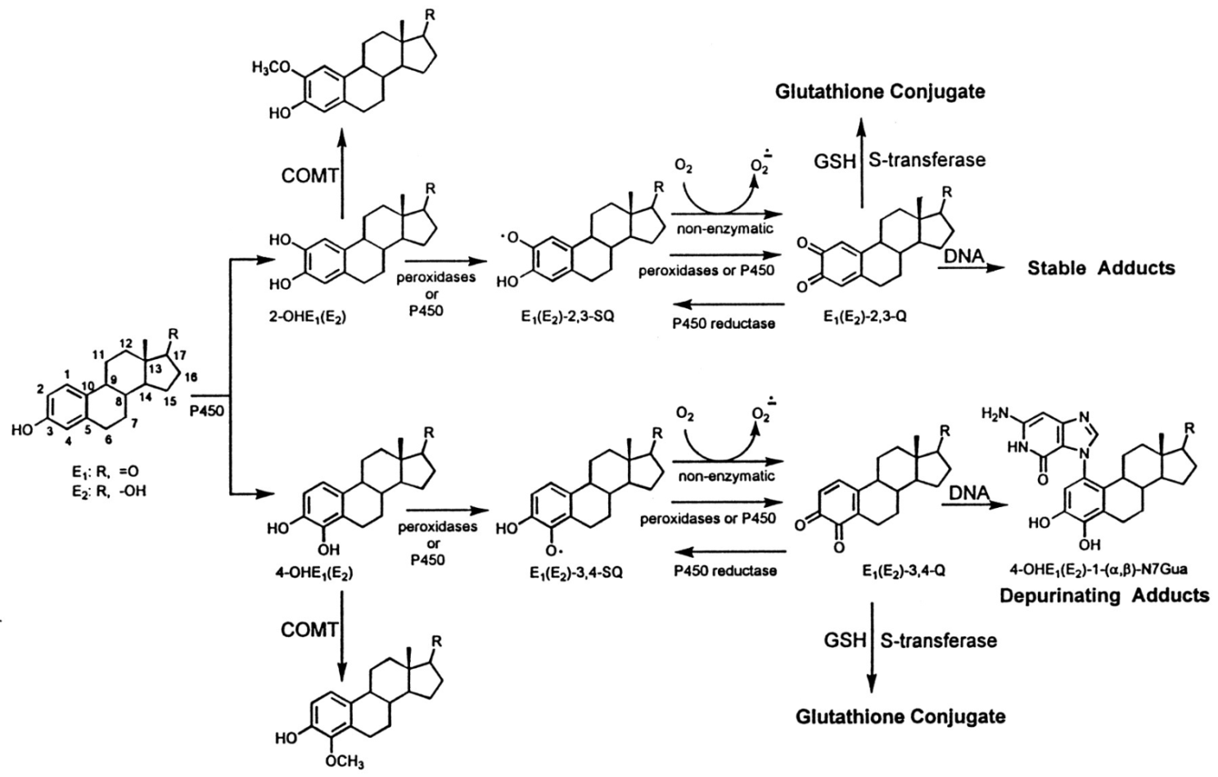

Slide 21
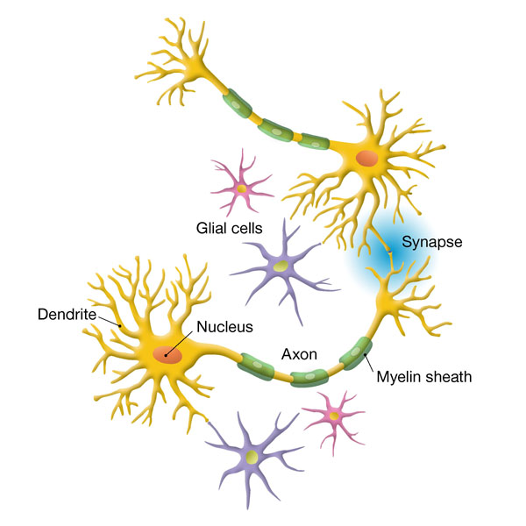
Multilayer Perceptron
B
Once A fires, travels to all the terminals of the axon.
At each terminal, chemicals are released.
The chemicals then go to the surface of the dendrite of B.
An electrical signal is generated at the dendrite of B. Its strength depends on the property of the synapse (contact point).
If the signal at the dendrite is large enough, B fires.
A

Slide 22
Multilayer Perceptron

Slide 23
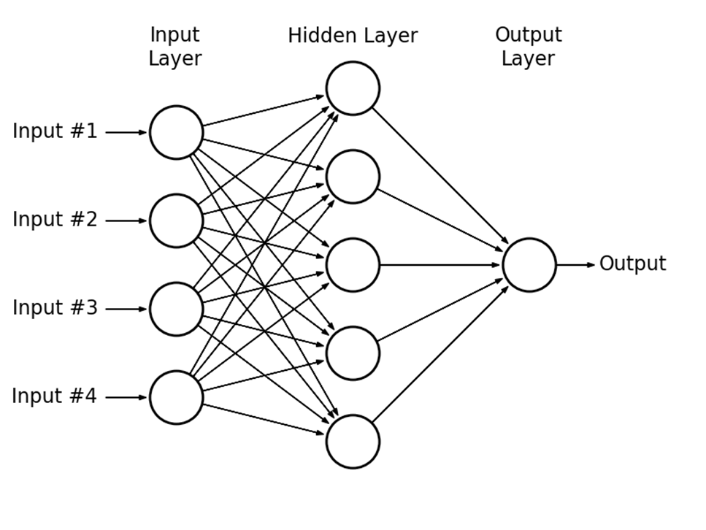
Multilayer Perceptron
MLP model:
No. of inputs.
No. of hidden neurons.
No. of output neurons.
Values of the weights.
Values of the thresholds

Slide 24
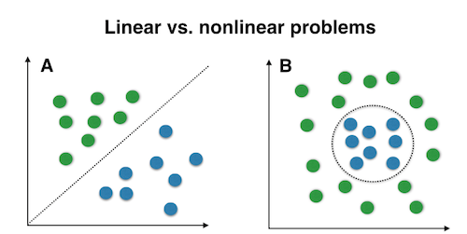
Multilayer Perceptron

Slide 25
Multilayer Perceptron
Please look at the blackboard!

Slide 26
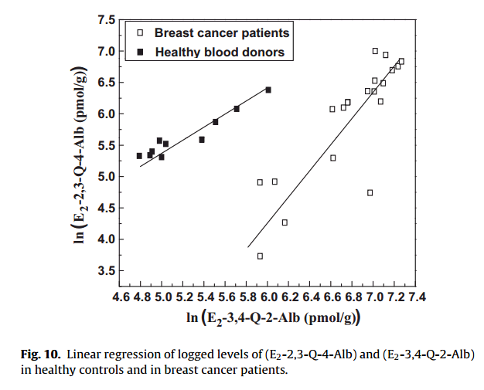
P.H. Lin and Co-workers (2011)

Slide 27
P.H. Lin and Co-workers (2013)

Slide 28
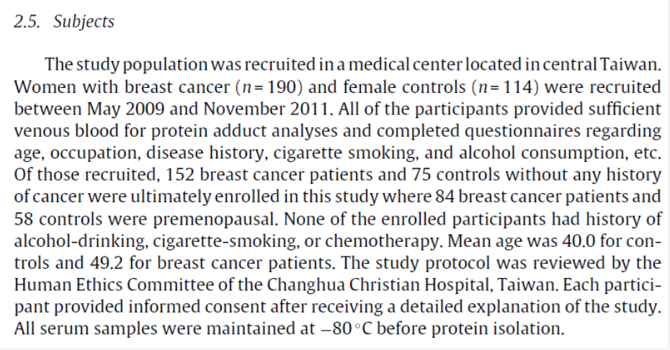
P.H. Lin and Co-workers (2013)

Slide 29
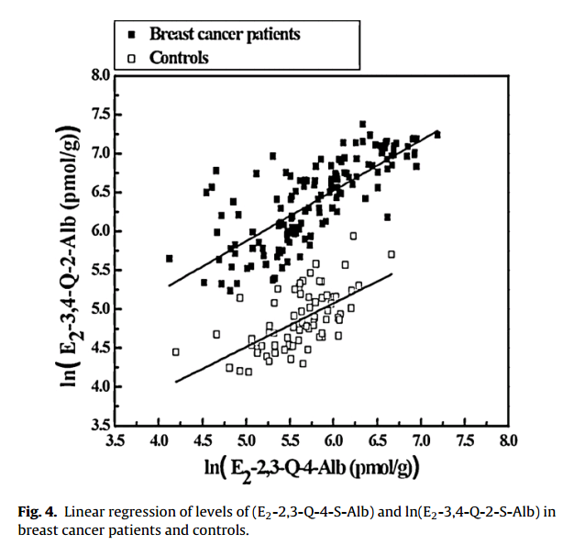
P.H. Lin and Co-workers (2013)

Slide 30
P.H. Lin and Co-workers (2014)

Slide 31
P.H. Lin and Co-workers (2014)

Slide 32
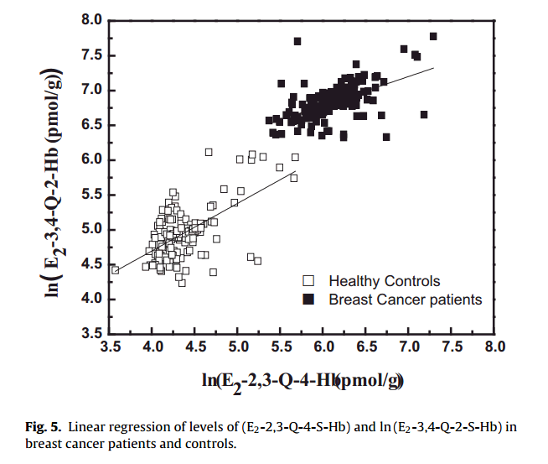
P.H. Lin and Co-workers (2014)

Slide 33
Summary of Previous Works
Single biomarker
  E2-2,3-Q-4-Hb, E2-2,3-Q-4-Alb, E2-3,4-Q-2-Alb alone are not able to differentiate healthy group and cancer group.
  E2-3,4-Q-2-Hb is able to do so.
    But, the gap between the healthy group and the cancer group is too small.
    This could be sensitive to any erroneous data.

Slide 34
Summary of Previous Works
Two biomarkers
  Using E2-2,3-Q-4-Alb and E2-3,4-Q-2-Alb, it is not able to differentiate healthy group and cancer group.
  Using E2-2,3-Q-4-Hb and E2-3,4-Q-2-Hb, it is able to do so.
    But, the gap between healthy group and the cancer group is too small.
    This could be sensitive to any erroneous data.

Slide 35
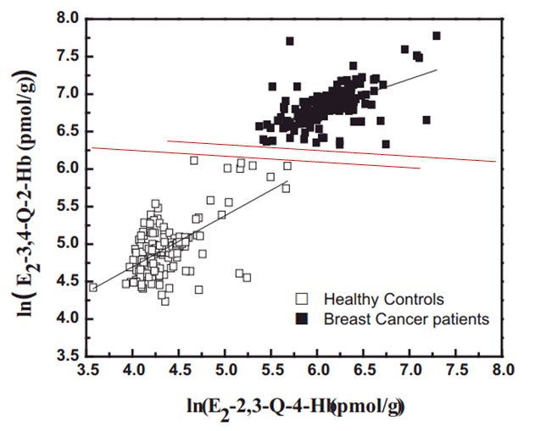
Summary of Previous Works

Slide 36
Summary of Previous Works
Avg. pmol/g protein | Hemoglobin Adducts |  | Albumin Adducts
 | E2-3,4-Q | E2-2,3-Q | E2-3,4-Q | E2-2,3-Q
Healthy Control | 154 | 82 | 140 | 296
Cancer Patient | 965 | 487 | 697 | 406

Slide 37
Summary of Previous Works
Avg. pmol/ml blood | Hemoglobin Adducts |  | Albumin Adducts
 | E2-3,4-Q | E2-2,3-Q | E2-3,4-Q | E2-2,3-Q
Healthy Control | 23.1 | 12.3 | 4.2 | 8.88
Cancer Patient | 144.7 | 73.05 | 20.91 | 12.18

Slide 38
Breast Cancer Risk Prediction
Using E2-2,3-Q-4-S-Hb and E2-3,4-Q-2-S-Hb as biomarkers, we are able to differentiate the healthy group and the cancer group.
However,
  we can see that the boundaries of two groups are still very close. The classification could thus be sensitivity to any erroneous data.
Question:
  Is it possible to improve the robustness of the classification?
Idea:
  Using multiple biomarkers
  Using nonlinear decision boundary surface

Slide 39
Breast Cancer Risk Prediction
Risk prediction is a classification problem
Models
  Linear logistic regression
  Nonlinear logistic regression, i.e. multilayer perceptron (MLP)
Improvement
  Accuracy
  Robustness
Minimum number of biomarkers

Slide 40
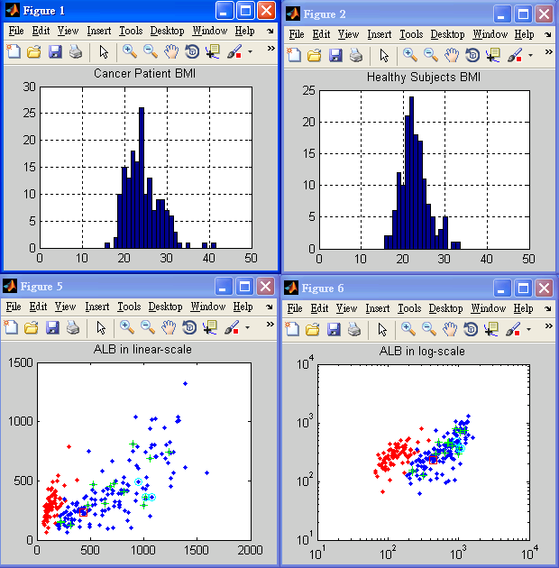

Slide 41
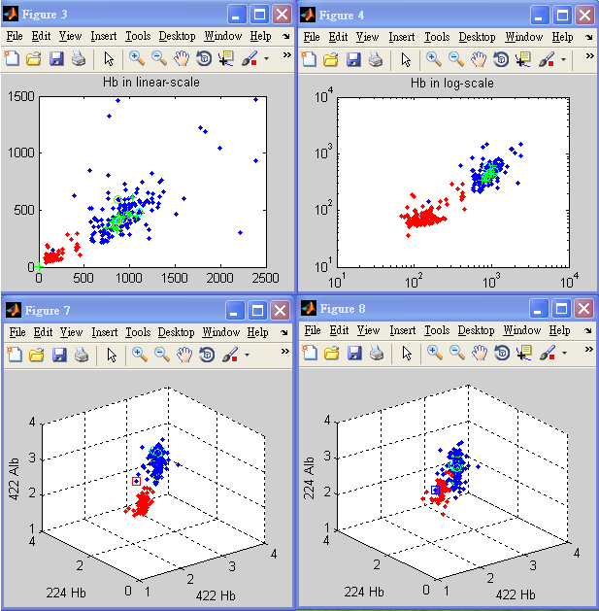

Slide 42
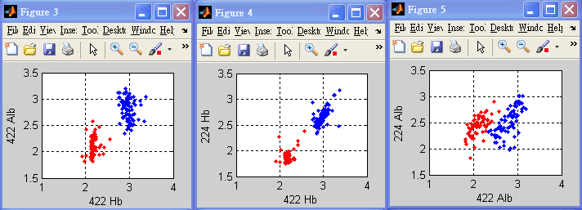
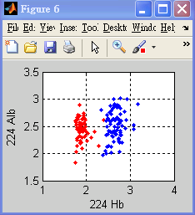
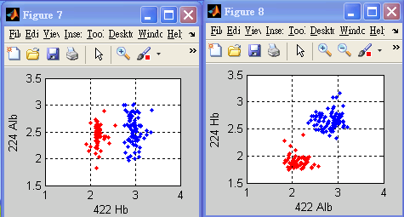
Age Below or Equal 50

Slide 43
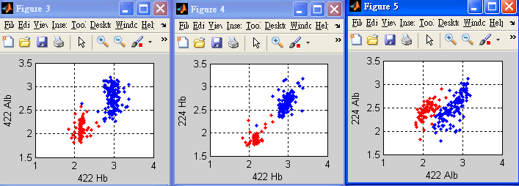
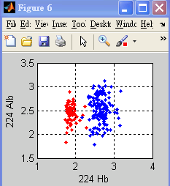
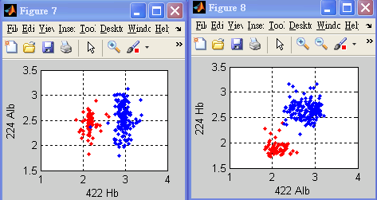
All Ages

Slide 44
Idea
Given a set of N samples from both healthy and cancer females, (x1, y1), (x2,y2), …, (xN, yN), where xk is a vector. For k = 1, …, N,
  elements in xk correspond to the value of a biomarker,
  yk = 0 if the female is a healthy person, and
  yk = 1 if the female has cancer.
Given a model f(x,w), where w is the parametric vector.
  Linear logistic regression model
  Multilayer perceptron
The output of these models could be treated as the probability that a female will have cancer for an input x.

Slide 45
Idea
Problem: To find w for the model f(x,w) such that f(x,w) can predict the risk.
Decision boundary: f(x,w) = 0.5.

Slide 46
Example
400 samples
  200 training samples
  200 testing samples
MLP
  3 input nodes, 10 hidden nodes, 1 output node
  2,500,000 training steps
  Learning rate 0.1
  Weight decay 0.0001

Slide 47
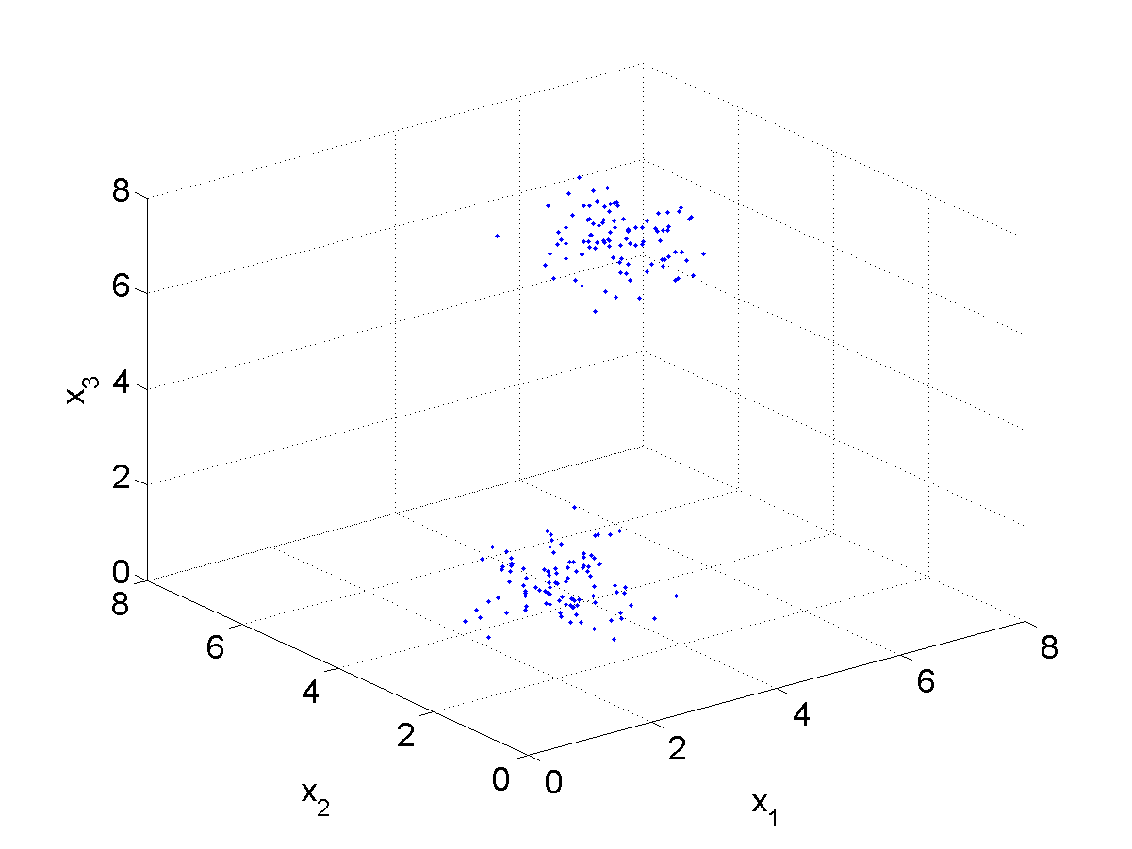
Example
Training Samples

Slide 48
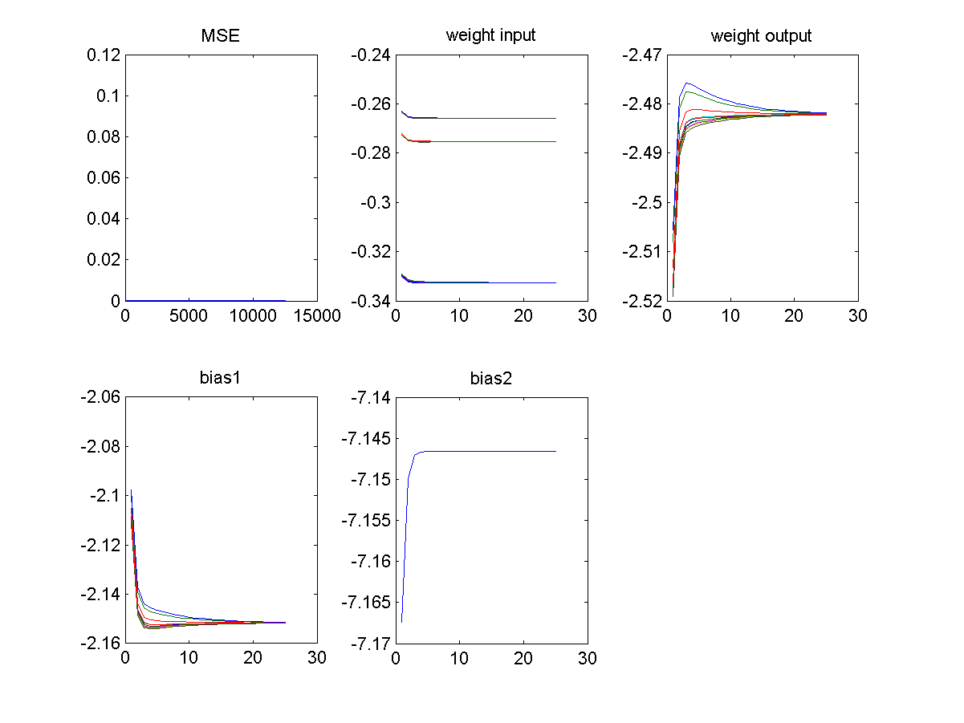
Example

Slide 49
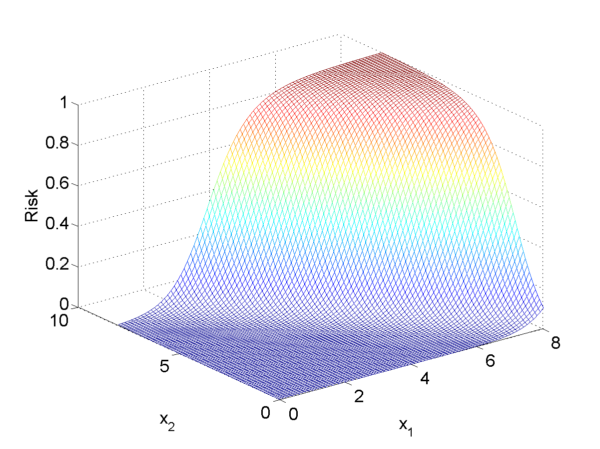
Example
Risk function: f(x1,x2,0,w)

Slide 50
Selection of Weight Decay
By cross validation, i.e. the testing error (not by the training error)
Testing error is an indication of the prediction error, i.e. goodness of fit
Mean prediction error

Slide 51
Testing of Significances
Parameters
  Leave one out cross validation (simulation based)
  Fisher information matrix (numerical method)
Model
  Cross validation (i.e. testing dataset)
  Mean prediction error

Slide 52
Anticipated Contributions
By setting f(x,w) = 0.5 to get the decision boundary for identifying low risk and high risk female.
Using the model output to predict the risk of a female who might have cancer.

Slide 53
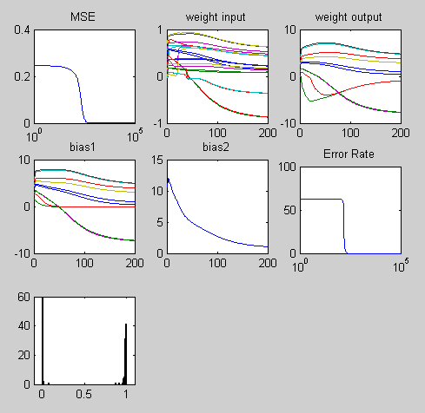
422 Hb with 422 Alb
MLP Model
  Input units: 2
  Hidden units: 10
  Output unit: 1
  Weight decay factor: 0.0001
  Training steps: 100000
Inputs:
  Concentrations of E2-3,4-Q-Hb and E2-3,4-Q-Alb in natural logarithm scale
Output:
  Risk prediction, [0 1].
Samples:
  Age below or equal to 50.

Slide 54
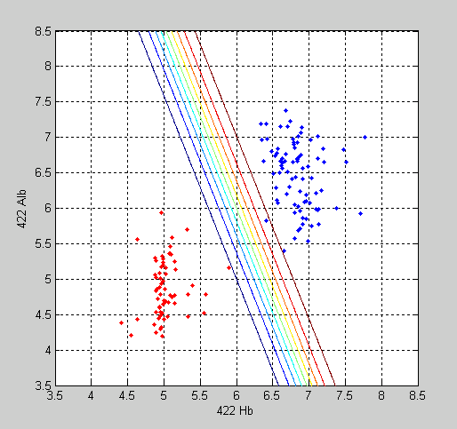
422 Hb with 422 Alb
Red dots:
  Healthy control group.
Blue dots:
  Cancer patients group
Contour lines:
  From left to right, correspond to the risk factors 0.1, 0.2, 0.3, 0.4, 0.5, 0.6, 0.7, 0.8 and 0.9.

Slide 55
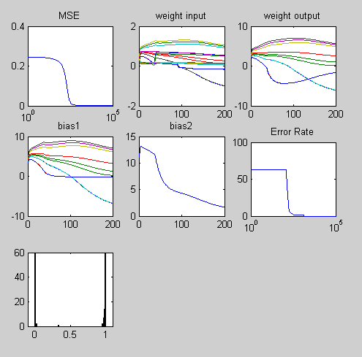
422 Hb with 224 Hb
MLP Model
  Input units: 2
  Hidden units: 10
  Output unit: 1
  Weight decay factor: 0.0001
  Training steps: 100000
Inputs:
  Concentrations of E2-3,4-Q-Hb and E2-2,3-Q-Hb in natural logarithm scale
Output:
  Risk prediction, [0 1].
Samples:
  Age below or equal to 50.

Slide 56
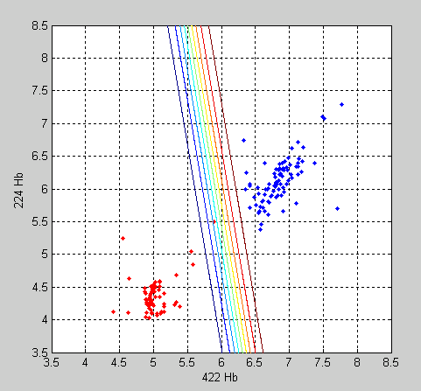
422 Hb with 224 Hb
Red dots:
  Healthy control group.
Blue dots:
  Cancer patients group
Contour lines:
  From left to right, correspond to the risk factors 0.1, 0.2, 0.3, 0.4, 0.5, 0.6, 0.7, 0.8 and 0.9.

Slide 57
Further Enquires: pfsum@nchu.edu.tw

