Slide 1
History of Computers
Dr. John Sum
Institute of Technology Management
National Chung Hsing University
Introduction to Computer Science
1

Slide 2
Computer is …, computer can …, network of computers can …
Computer is part of an information system.
Computer is able to process data (computation) and store data.
Standalone computers can do many things.
File storage
Word Processing (e.g. MS Word)
Data storage (e.g. MS Access)
Data analysis (e.g. MS Excel, SAS, SPSS)
Computer games (e.g. Games in Window)
Scientific researches (e.g. Matlab, Mathematica)
Drawing and photo editing (e.g. Corel Draw, Photoshop)
Reading document (e.g. MS WORD, Adobe Reader)
Music/Video (e.g. Real Player, Media Player)
With network technologies, computers can do even more.
Introduction to Computer Science
2

Slide 3
Simple versus complex computers
No matter what, the basic function of a computer is to perform computation.
Simple computing machines.
Egyptian Abacus, Chinese Abacus
Simple to use, calculating by hand (human being is the machine)
Complex computing machines
Jacquard Looms
Babbage Difference Machine
Programmable, calculating by machine
Even more complex computing machines
Mainframe, workstations, PC, smartphones
Introduction to Computer Science
3

Slide 4
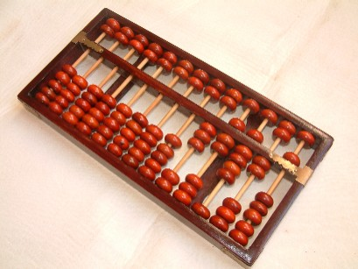
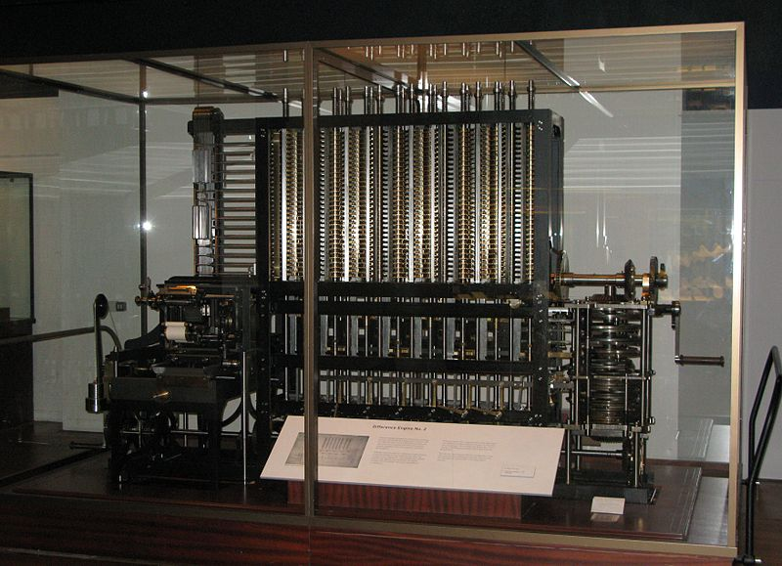
Chinese Abacus
Babbage Difference Machine
Introduction to Computer Science
4

Slide 5
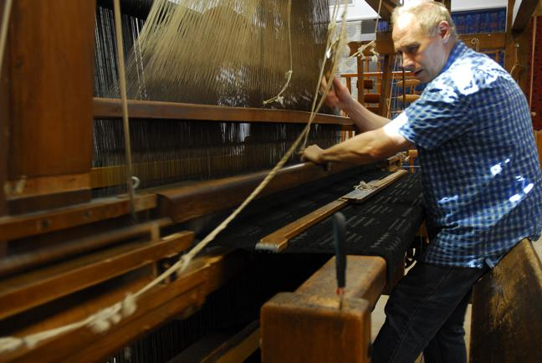
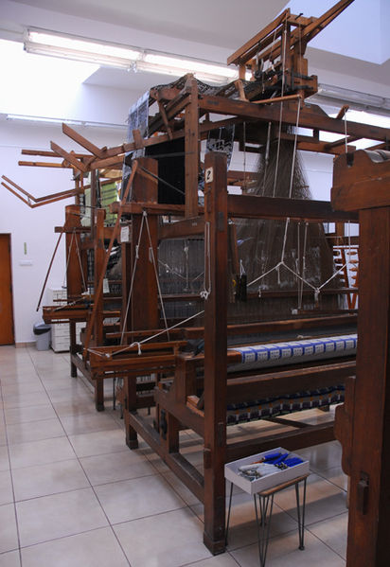
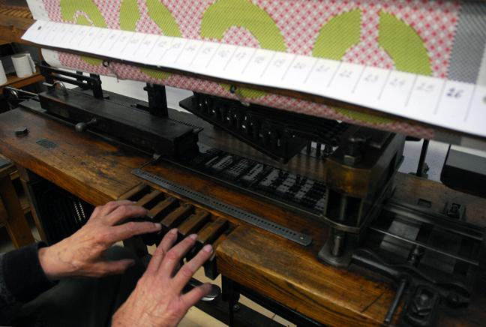
Jacquard Looms
Introduction to Computer Science
5

Slide 6
Simple versus complex computers
Abacus and Babbage Difference Machine are designed for special uses.
Abacus is for addition.
BDM is for doing approximation.
Instructions are simple, i.e. easy to learn.
Contemporary computers are designed for general use.
Their instructions (the hardware) are complex, i.e. difficult to learn.
To have a complete understand of how to use, enroll the computer science program.
Introduction to Computer Science
6

Slide 7
Inventions (Computing Machine)
1800 Electricity (Alessandro Volta)
1801 Jacquard Looms (Joseph Marie Jacquard)
1836 Differential Analyzer (Gaspard-Gustave Coriolis)
1837 Analytic Engine (Conceptual machine, by Charles Babbage)
1878 Filament Lamp (Thomas Edison)
1878 Power generators, driven by steam engines
1888 Babbage Difference Machine (Henry Babbage)
1890 Tabulating Machine (Counting Machine, by Herman Hollerith)
1904 Vacuum Tube (John Ambrose Fleming)
1906 Diode, triode, other electronic components
Introduction to Computer Science
7

Slide 8
Inventions (Communication)
1792 – Claude Chappe establishes the first long-distance semaphore telegraph line.
1831 – Joseph Henry proposes and builds an electric telegraph.
1836 – Samuel Morse develops the Morse code.
1843 – Samuel Morse builds the first long distance electric telegraph line.
1876 – Alexander Graham Bell and Thomas A. Watson exhibit an electric telephone in Boston.

Slide 9
Generations of Computers
First Generation Computers (Use of vacuum tubes)
1936 Algorithm, computation, Turing Machine (Conceptual model for a electronic computer, Alan Turing)
1937-41 Atanasoff–Berry Computer (First digital electronic computer, not programmable, Iowa State College)
1941 German Z3 (First store-program general purpose computer, Konrad Zuse)
1943 Colossus (Tommy Flowers, UK)
1944 Mark I (Howard H. Aiken designed, IBM built)
1945 Von Neumann Model (Conceptual model for a stored-program computer, John von Neumann)
1946 ENIAC (Electronic Numerical Integrator and Computer, John Mauchly and J. Presper Eckert, University of Pennsylvania)
1948 ENIAC was enhanced to be programmable
Introduction to Computer Science
9

Slide 10
Generations of Computers
Second Generation of Computers (Semiconductor transistors)
1947 Transistor (John Bardeen and Walter Houser Brattain, William Shockley at Bell Lab)
1951 Lyons Electronic Office (J. Lyons and Co.)
1953 First Transistor Computer (U. Manchester, UK)
1952 IBM 701
Third Generation of Computers (Use of IC)
1964 IBM System/360 (Made of transistors and microchips)
Fourth Generation of Computers (Microprocessors)
1965 Programma 101
1971 Intel 4004 CPU
Introduction to Computer Science
10

Slide 11
Generations of Computers
Fifth Generation of Computers (Microprocessor)
Personal computers
Single CPU (single-core)
Text-command OS control
Sixth Generation of Computers
Personal computers, single-core CPU
Text-command and graphical user interface (GUI)-command OS control
Seventh Generation of Computers
Personal computers, multi-core CPU and GPU
Text-command, GUI-command and voice-command OS control

Slide 12
Computer Programs
Computers
Perform calculation and store data
Non-programmable or programmable
Input/Output devices for users
Programs (c.f. Procedure)
Instructions for a set of components to work together
Component: Mechanical machine, electronic logic gates, human workers in an organization (SOP)
Levels: Machine code → Low level programs (Assembly Lang) → Middle level programs (C Language) → High level programs (SQL) → Application programs (Access)
Introduction to Computer Science
12

Slide 13
Review Questions
What is the fundamental purpose of a computer?
What is the use of the Babbage Difference Machine?
What is the contribution of Thomas Edison in the history of computer?
When did IBM manufacture her first digital electronic computer?
What major inventions led to the first, second, third and fourth generations of computers?
To control a computer, we need __________.
(*) What are the similarities between a computer and a firm?
Introduction to Computer Science
13

Slide 14
Review Questions
In accordance with the level of difficulty, what should be the correct ranking of the following skills.
Knowing how to use a system software, like Windows and Mac OS.
Knowing how to build a system software, like Windows and Mac OS.
Knowing how to use an application software, like MS WORD.
Knowing how to build an application software, like MS WORD.
Introduction to Computer Science
14

Slide 15
Review Questions
In accordance with the level of difficulty, what should be the correct ranking of the following skills.
Knowing how to use a CPU.
Knowing how to build a CPU.
Knowing how to design a new model of CPU.
Knowing how to design a multi-core system of CPUs.
Introduction to Computer Science
15

Slide 16
Additional Information
History of Computers
http://www.youtube.com/watch?v=2JPaVZ8jUj0
Wikipedia
BBC Documentary: History of Computers
http://www.youtube.com/watch?v=NbhbssXWDAE&feature=rellist&playnext=1&list=PLDE8FF57B9EF2D4D2
Introduction to Computer Science
16

