Slide 1
II. Business Processes, IS and IT
EC Websites Development
1

Slide 2
Processes, IS and IT
Enterprise makes money out of provision of services or selling products to their customers.
Business model (see the next slide)
  Overall picture describing the relationship amongst the enterprise, its customers and suppliers.
  Services or products are provided to the customers.
  Services or products that are needed from the suppliers.
  Product flows and Cash flows amongst the customers, enterprise and the suppliers.
Business processes (i.e. operations) are the activities (can also called tasks) that support the provision of the services or products to the customers.

Slide 3
Processes, IS and IT
Customer X
Product X
Supplier 1
Cash Flow
Customer Y
Product Y
Supplier 2
Firm
Customer Z
Product Z
Supplier 3
Customer A
Product A
Product Flow
Supplier 4
Customer B
Product B
Materials

Slide 4
Service Delivery Process
(Routine work)
-Repeated every month, every week, every day
R&D: New product design, new service delivery process
R&D
Marketing/Sales
Customer Service
Services from
Suppliers
Services/Products
to Customers
Management Process
-Quality Control
-Schedule Tracking
Bank & Investors
Management Processes
Finance/Acct. (Process)
HR (Process)
Support Processes
Business Development
IT Mgt
External Organizations

Slide 5
Conceptual Diagram of an Organization Design
R&D
Marketing/Sales
Customer Service
Services from
Suppliers
Services/Products
to Customers
Service Delivery Process
Management Processes
Service Encounter
Finance/Acct. (Process)
HR (Process)
Business Development
IT Mgt

Slide 6
Processes, IS and IT
6

Slide 7
Website and Information System
A website is simply a part of a company’s information system.
K.Laudon and J.Laudon, Management Information Systems, 13th ed., Pearson, 2014. (p.45)
  Definition: An information system is a set of interrelated components that collect (or retrieve), process, store, and distribute information to support decision making and control in an organization.
2010 FALL
7

Slide 8
Processes, IS and IT
Information technologies provide the infrastructure and support to build an information system to support the business processes (i.e. operations).
Business Processes
Information Systems
Information Technologies
Suppliers
Customers
8

Slide 9
Processes, IS and IT
Example: SKYPE
Services
  Skype to Skype
  Call-In Service
  Call-Out Service
  Phone to Phone
  Skype Manager
  Skype Connect
Customers
  Individual
  Corporate
Suppliers
  Local Telecoms
  Local Partners
  Ad Services Partners

Slide 10

Individual
Skype to Skype
Call-In Service
Telecom
Call-Out service
Phone to Phone
Partner
Skype to Skype
Call-In Service
Call-Out service
Ad Service Partner
Phone to Phone
Skype Manager
Skype Connect
Corporate
Notes:
10

Slide 11






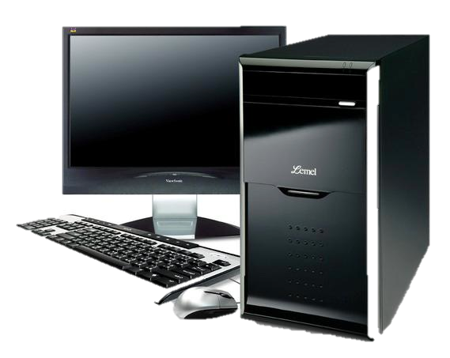

Skype server
A
B
Local Telecom A
Local Telecom B
Internet
PC A
PC B
Notes:
11

Slide 12
公司營運(Business Processes)
Business Management
SCM
Adminstration
CRM
Mgt Info. System
Information Management
DB
Internet
OS
SW Tech
HW Tech
Information Technologies
12

Slide 13
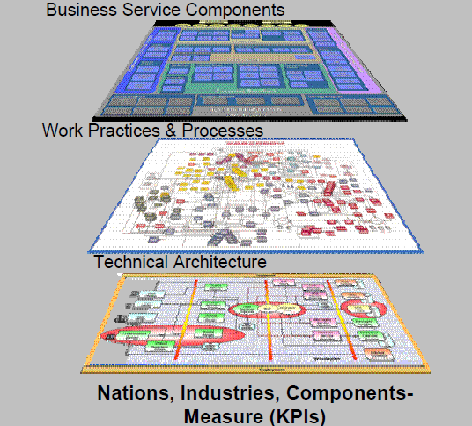

Slide 14
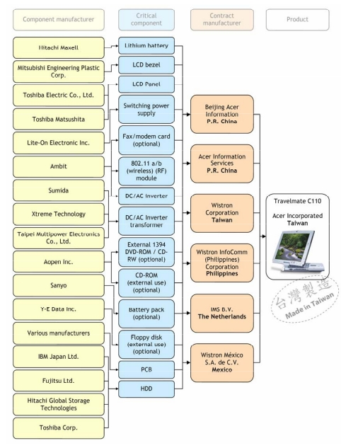
Business processes, in general, cannot be defined solely by looking at your own enterprise.
Define the business processes from the products/services supply chain view.

Slide 15
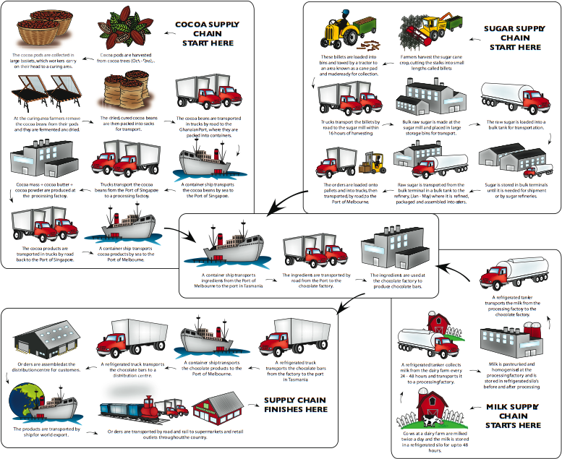
Will come back to this “Services” concept in the “Advanced Topics”.

Slide 16
Processes, IS and IT
To understand the business operations of an organization, one needs to analyze from three different level of perspectives.
  Organizational level.
  Supply chain (resp. network) level.
  Industrial network (resp. ecosystem) level.
Different levels have different constraints on an organization.
Ultimately, holistic view is the goal.

Slide 17
Business Management
Business management is referred to the methods and practices of the usage of the resources within an organization to accomplish the goals of the organization.
Business management is also referred to the methods and practices of the acquisition of the resources to an organization to accomplish the goals of the organization.

Slide 18
Business Management
(Accessible) Resources
  Human
  Finance
  Technologies
    Information technologies
    High tech
  Connections
    Investor relations
    Customer relations
  Products and services

Slide 19
Information Management
Information management is referred to the methods and practices of the usage of the information technologies within an organization to accomplish the goals of the organization.
Information management is also referred to the methods and practices of the acquisition and the development of the information technologies to an organization to accomplish the goals of the organization.

Slide 20
Technology Management
Technology management is referred to the methods and practices of the usage of the technologies within an organization to accomplish the goals of the organization.
Technology management is also referred to the methods and practices of the development of the technologies to an organization to accomplish the goals of the organization.

Slide 21
Intelligent Technology Management
Intelligent technology management is referred to the methods and practices of the usage of the intelligent technologies within an organization to accomplish the goals of the organization.
Intelligent technology management is also referred to the methods and practices of the acquisition and the development of the intelligent technologies to an organization to accomplish the goals of the organization.

Slide 22
(Intelligent) Technology Management
Three important issues to be aware of.
  Manage the usage of the accessible (intelligent) technologies.
  Manage the acquisition (i.e. purchase or license) and the development of an inaccessible (intelligent) technology.
  Manage the sales or licensing of a (intelligent) technology (or product).

