Slide 1

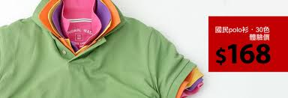
E-Commerce Website Development Mini-Project
Advisor: John Sum
Team 4 :
7100026114 Ariel
7099026110 Stephen
7100026104 Mars
7100026108 Aaron

Slide 2

Outline
Introduction of lativ.com.tw
Marketing Strategy
Purchase Process & Website Interface
Business Model & Business Operation
Underlying technologies
Comments

Slide 3

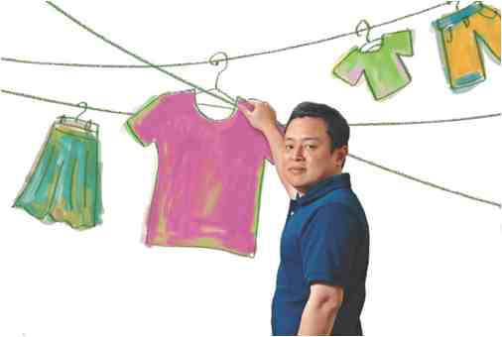
Introduction
Guess what is the first suggestion you get when you type “L” in search engine.
lativ

Slide 4
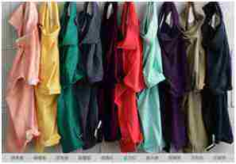


Background
$168
張偉強
Marketing
Design
UNIQLO ?
MIT
Logistics
Quality
Half Price!

Slide 5
Growth of Revenue
Found in 2007, the following table shows the growth
of it’s revenue
Year | Revenue (billion)
2007 | 0.01
2008 | 0.1
2009 | 0.37
2010 | 1.5
Source:商業周刊 第1201期 2010-11-29
Notes:
To thirty-eight color, one hundred sixty-eight yuan's famous polo shirt
Established in 2007, revenue three years ago. 6.7 billion in revenue last year explosion
Hair growth, reaching 1.5 billion, growth of more than 300%.
Positioning in a simple, only in color, the version with a little printing chart
Make changes on the case, never to catch additional flow Sulei Si by popular
And other accessories.

Slide 6
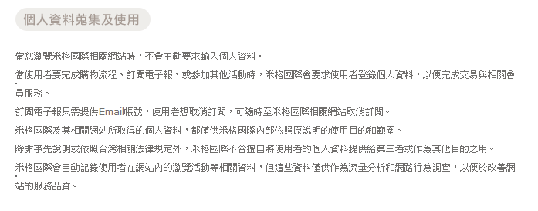
Marketing strategy
Half price, same quality
Finding depth and extent of customer ‘s need
Collect feedback and display it on website
Observing “User Access log” of the website
3. Key words advertising
User Access Log
Notes:
1.與競爭對手相比,提供半價卻同品質的服裝
2. 仔細觀察消費者的需求與意見
a. 利用留言板收集feedback
b. 利用儲存在Server端的User Access log 紀錄使用者在站內的瀏覽活動,以進行消費者行為的
觀察
3. 利用關鍵字廣告放置於 各大網站

Slide 7
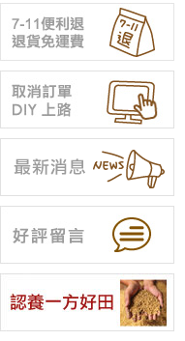
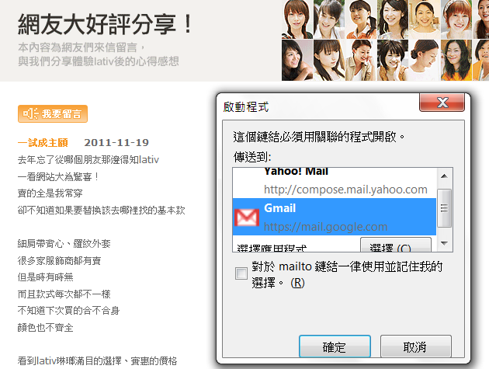
Guest board
Notes:
站內的好評留言
提供了收集客戶意見的平台以及讓其他使用者觀看已購買者的評論
不過收集的方式是以E-mail收集意見,無法直接留言在網站上

Slide 8
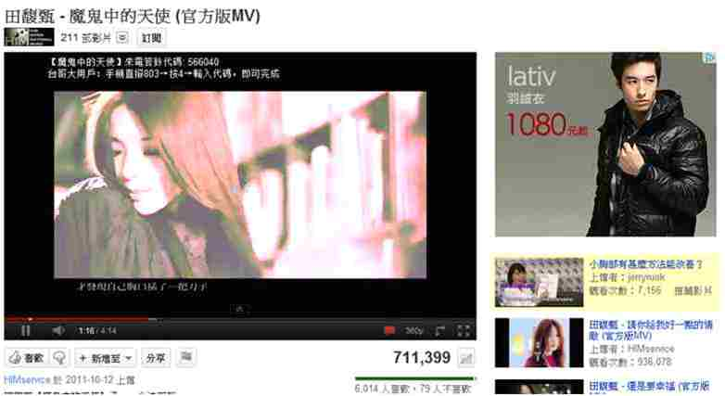
Advertisement

Slide 9
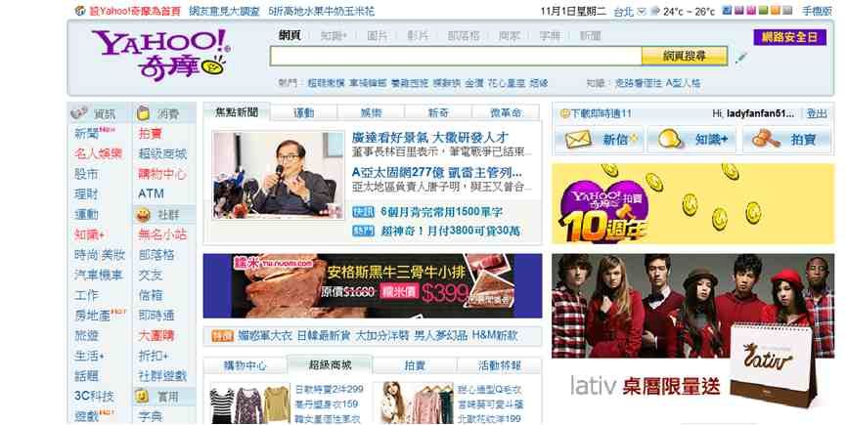
Advertisement

Slide 10

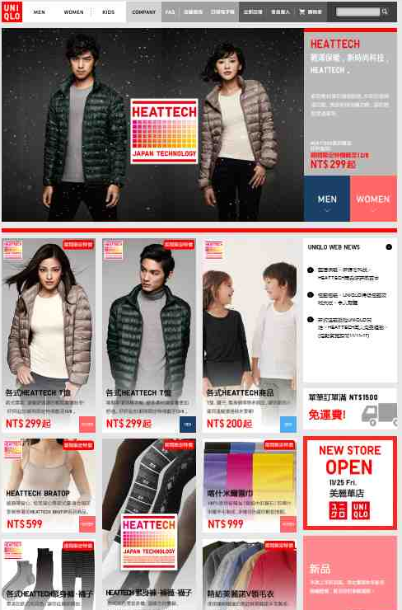
Website Interface

Slide 11
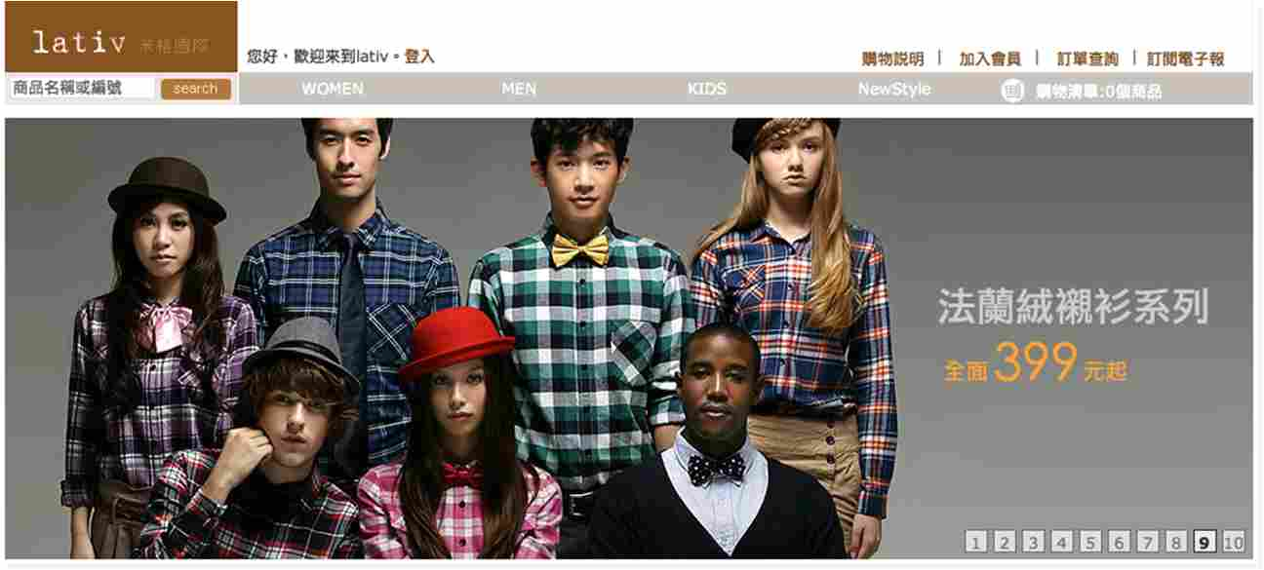


Website Interface
Check order
Subscribe e-paper
Search
About
Join
Log in
Categories

Slide 12
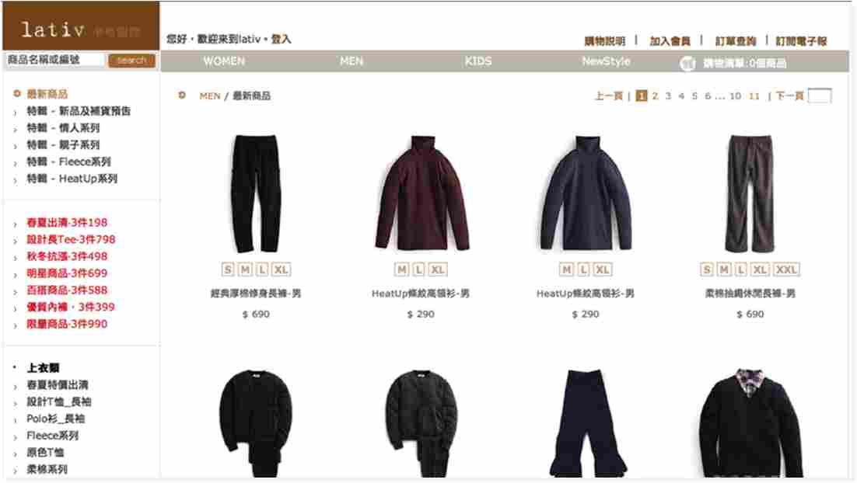


Website Interface
Newest
Product
Bargains

Slide 13

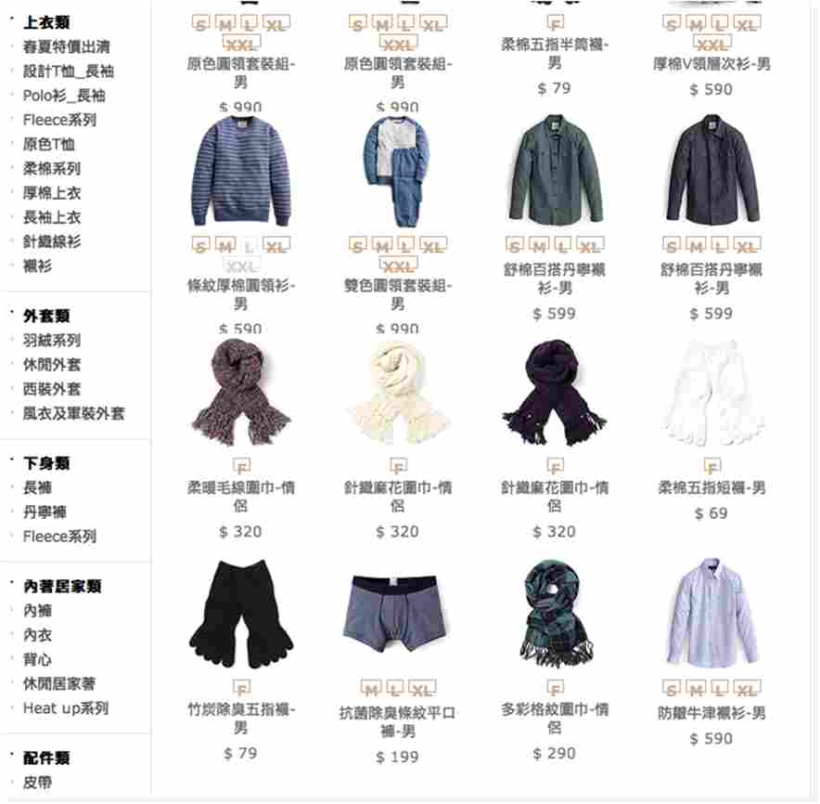




Website Interface

Slide 14
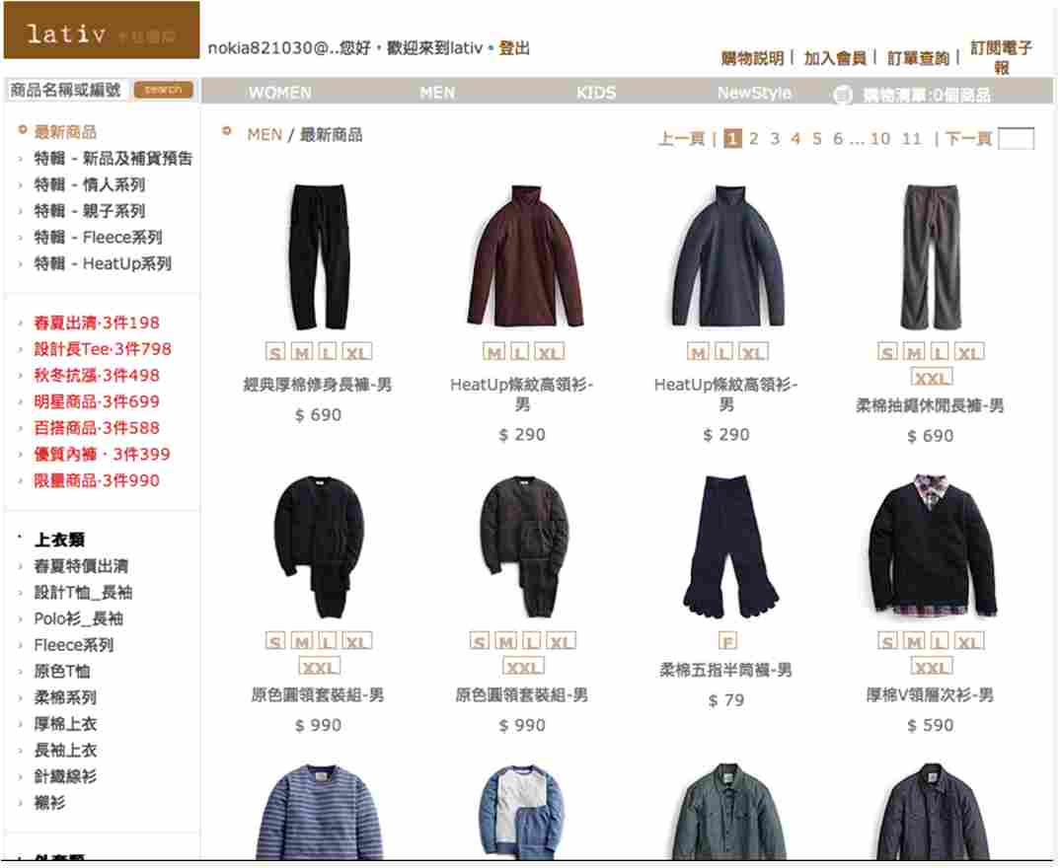

Shopping

Slide 15
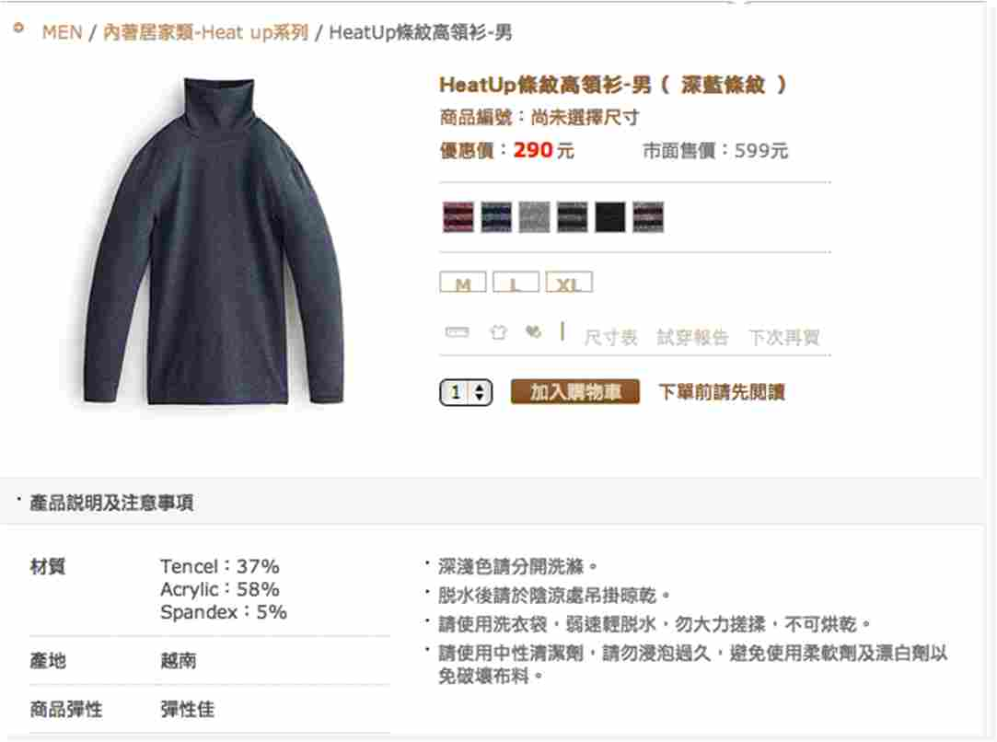


Shopping

Slide 16
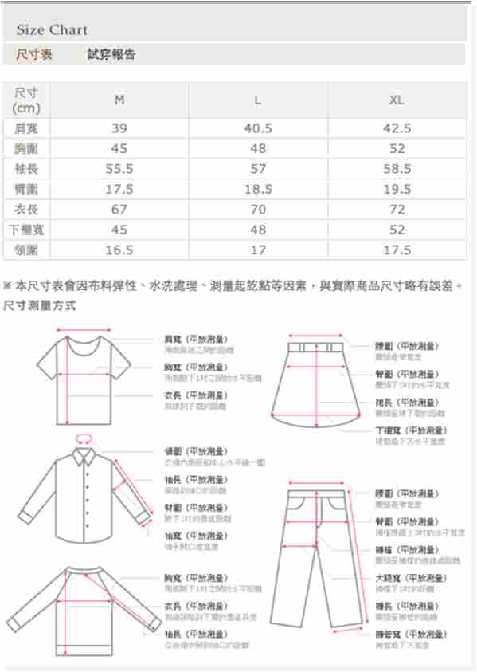
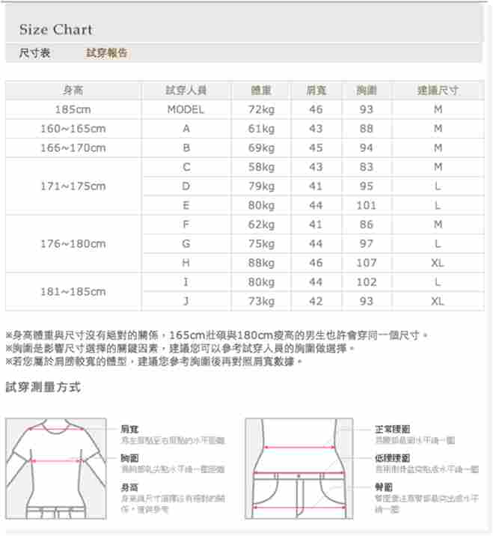
Shopping
Size Chart
Fitting Report

Slide 17
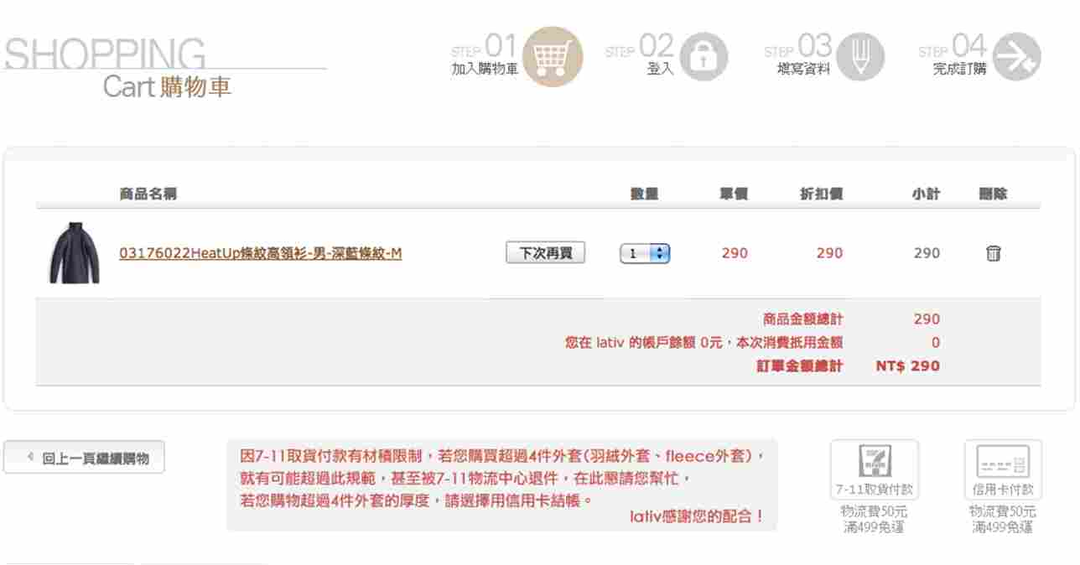

Payment
Choose payment

Slide 18

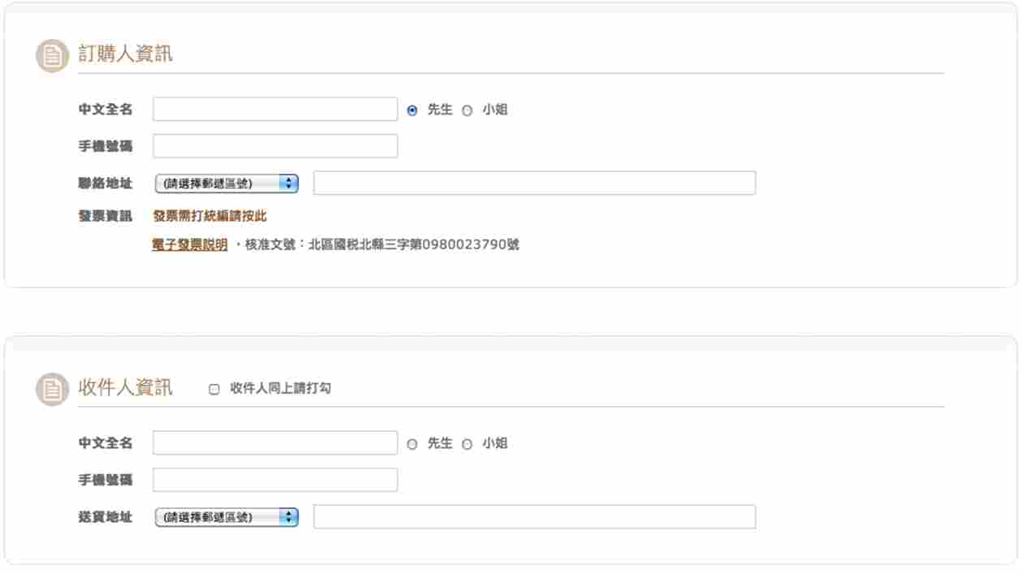
Payment

Slide 19
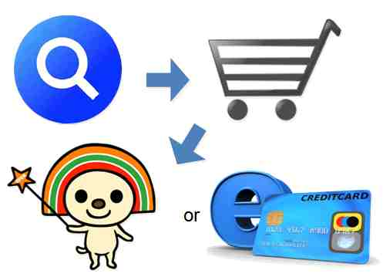
Purchase Process

Slide 20





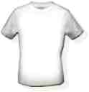

S u p p l i e r s
C u s t o m e r s

Slide 21


Past

Slide 22
Now

Slide 23


Target Customers
• Demographics : Adults, Parents
• Lifestyle : Simple, Fashion
• Needs/desires : High Quality, Fair Price
• Hopes/aspirations : Best quality with lowest price
• Fears/concerns : Poor quality clothing
• Product purchase behavior : Enjoy online shopping
Follow new trends
Simple
Family

Slide 24
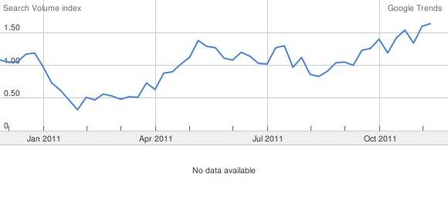
Organization
lativ
Procurement
Department
Product department
Marketing department
R&D
Department
Financial department
Human Resource
IT department
Logistic department
Procure materials
Design and merchandising
Quality control & Monitoring the schedule
Marketing plan
Funds & cost management
Recruitment & training
Website development
Warehouse & logistic planning
Customer service
Collect feedback
Call service
Employees: 230
104 Job Bank(11/26) :
Quality manager >30
Accountants >30
Procurement >30
Customer service r > 30
Human Resource > 30
From 104 人力銀行:http://www.104.com.tw/jobbank/joblist/joblist.cfm?jobsource=n104bank&jobact=relevance
Notes:
推估的lativ組織架構，工作內容會細講

Slide 25
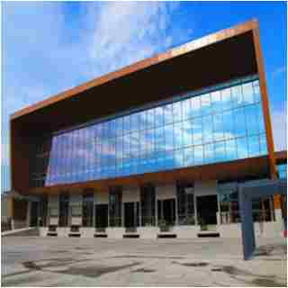
Business Operation- Logistics
Location: 桃園縣八德市建國路626號
Cost : 0.4 billion for land, 0.3 billion for logistics center
Functions: logistics & office
Logistics outsourcing cost
Office rental fee: $ 0
104 人力銀行:http://www.104.com.tw/jobbank/custjob/index.php?r=cust&j=5e4a4425346c3e6948423a1d1d1d1d5f2443a363189j01&jobsource=checkcpage%3D1
天下雜誌:http://taiwan.cw.com.tw/magazine/location_article9-3.aspx
經濟部:http://gcis.nat.gov.tw/pub/cmpy/cmpyInfoAction.do?method=detail&banNo=16230598#note

Slide 26


Business Operation- Website infrastructure
DNS: ns1.miniasp.com – Doggy Digital
Website : Doggy Digital
Server: JCNet Hermes M250
$118,923 (with OS)
Domain name registration cost $800/year (Seednet)
From JCNet: http://www.jcnetcorp.com/Public/F911.aspx?NewsCenter_ID=cf09ba93-6cc7-48ad-89d0-211978adbc25&News_ID=59dcd5e1-5750-46c3-ab08-ad357bf61385&NewsType=2
From miniasp.com :http://www.miniasp.com/

Slide 27




What are technologies behind?
Server environment ?
PHP(.php) or ASP.NET (.aspx) ?
http://www.lativ.com.tw/
http://www.pazzo.com.tw/Shop/index.aspx
http://www.illori.com.tw/index.php
http://www.sofu.com.tw/Category.aspx?ca=1&pid=oeya&member=af000047725
Notes:
Dynamic web pages

Slide 28
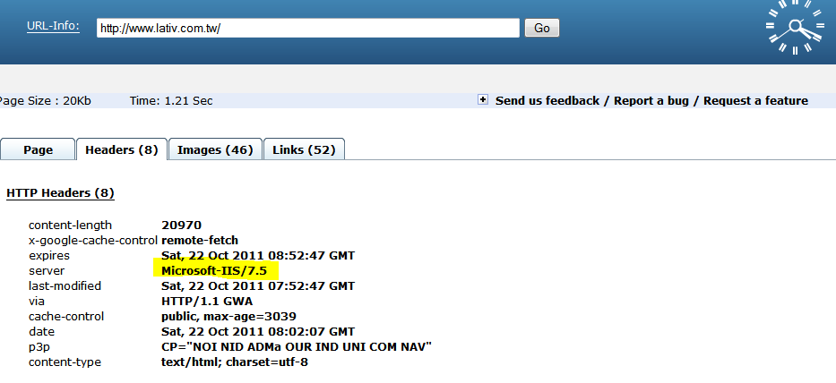
Server
MicrosoftASP.NET ?
Microsoft
IIS/7.4
http://url-info.appspot.com/

Slide 29
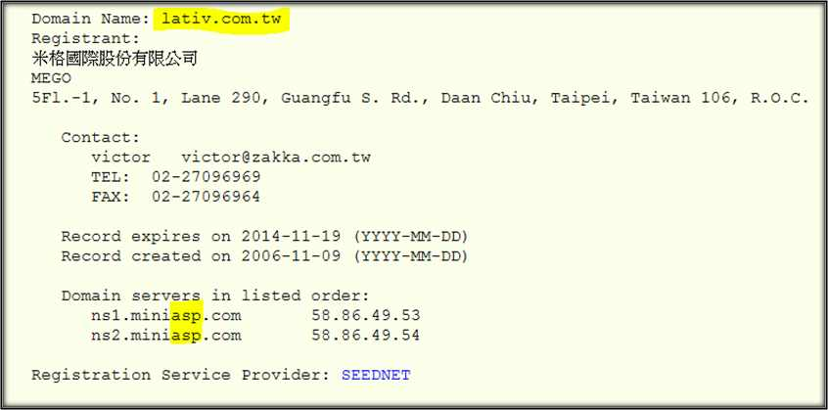
ASP.NET -cue 1
ASP.NET
From 域名入口網站TWNIC: http://www.twnic.net.tw/newdn/index.php

Slide 30
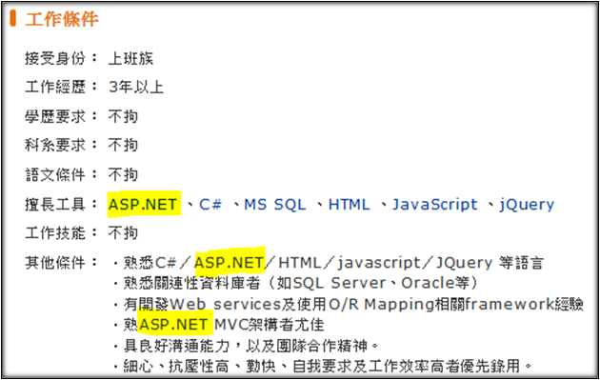
ASP.NET -cue 2
ASP.NET
From: 104 人力銀行http://www.104.com.tw/jobbank/custjob/index.php?r=cust&j=5e4a4425346c3e6948423a1d1d1d1d5f2443a363189j01&jobsource=checkcpage%3D1

Slide 31

How does lativ hide the original URLs
URL rewriting technology for ASP.NET
msdn’s article: ”To shorten those ugly URLs to meaningful, memorable ones”
http://yoursite.com/info/dispEmployeeInfo.aspx?EmpID=459-099&type=summary
http://yoursite.com/people/sales/chuck.smith
Notes:
the process of intercepting an incoming Web request and automatically redirecting it to a different URL

Slide 32
Links Analysis
https://www.lativ.com.tw/Home/Login---Login
https://www.lativ.com.tw/Home/Logout---Logout
https://www.lativ.com.tw/Home/Join---Join the member
https://www.lativ.com.tw/Home/Login?ReturnUrl=%2fMember---Chek order
https://www.lativ.com.tw/Home/EPaper---Subscribe the e-paper
http://www.lativ.com.tw/Home/NewStyle---The newest style
http://www.lativ.com.tw/WOMEN
http://www.lativ.com.tw/MEN
http://www.lativ.com.tw/KIDS
http://www.lativ.com.tw/OnSale/3P198
http://www.lativ.com.tw/Detail/03091031
Promotion Products
Product Pages
http://www.lativ.com.tw/Page/member_frequently_asked_questions
http://www.lativ.com.tw/Page/About
http://www.104.com.tw/jobbank/custjob/index.php?r=cust&j=5e4a4425346c3e6948423a1d1d1d1d5f2443a363189j01&jobsource=checkcpage%3D1#02
Recruitment Information

Slide 33
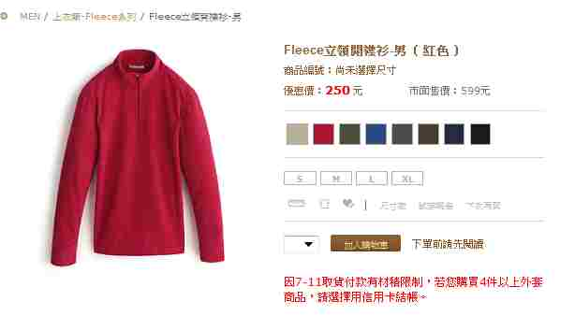
Products
http://www.lativ.com.tw/Detail/03181021
http://www.lativ.com.tw/Detail/03181 0 2 1
Product Number
Color
Size

Slide 34

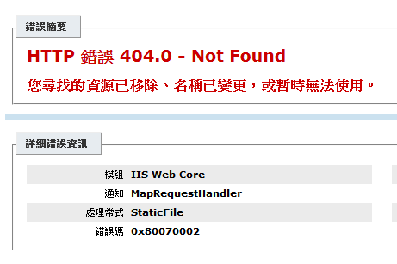
Picture server
Why do we look into picture server?
Server type? How many ? How do they store pictures?
http://i3.lativ.com.tw/i/0306704/0306704_02.jpg
Microsoft IIS server
http://i3.lativ.com.tw/i/0306704/0306704_03.jpg

Slide 35
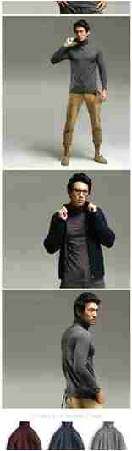
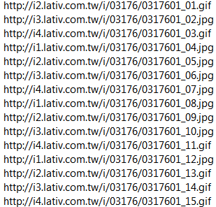
Picture server-Product 1
4 servers
Product number
Picture name

Slide 36
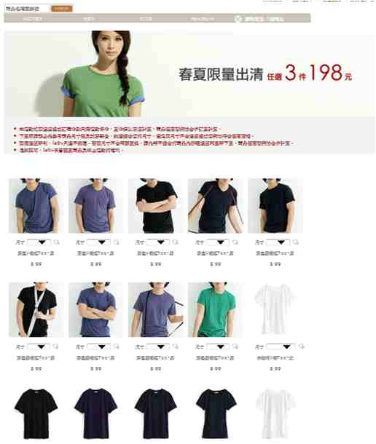
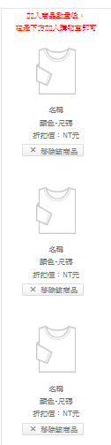
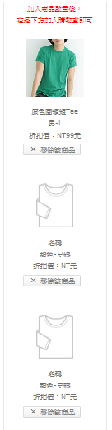
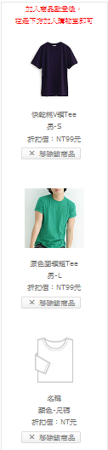
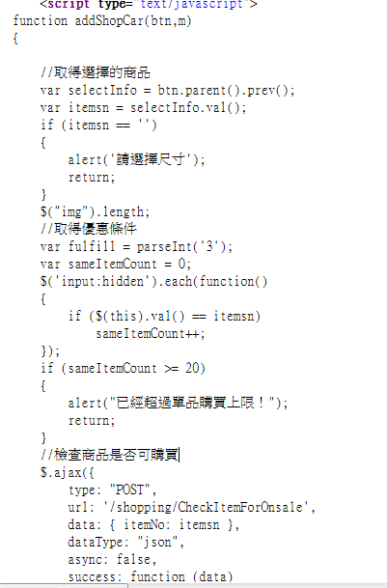
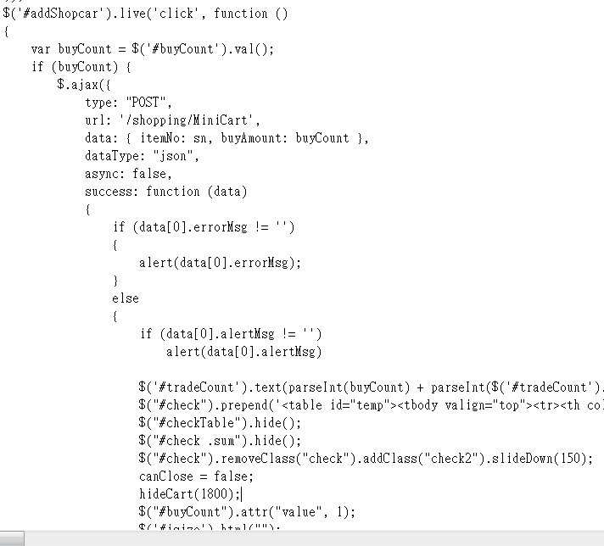
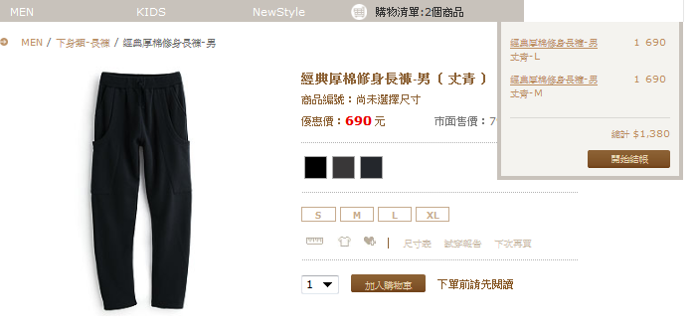
Featured Functions
Promotion Pages-Dynamic shopping cart:
http://www.lativ.com.tw/OnSale/3P198
Normal Products Pages-Mini Cart:
http://www.lativ.com.tw/Detail/03091031
Promotion Set
Promotion Page
Product Number
Normal Product Page

Slide 37
Comments

Slide 38
Guest board -
receive feedback only by “E-mail”
Subscribe news latter –
blocked by Hotmail.com
Customer Service center-
always busy, limited information

Slide 39
Thank you for listening!

Slide 40
Reference
Lativ
( http://www.lativ.com.tw)
From 域名入口網站TWNIC
(http://www.twnic.net.tw/newdn/index.php)
104 人力銀行(http://www.104.com.tw/jobbank/custjob/index.php?r=cust&j=5e4a4425346c3e6948423a1d1d1d1d5f2443a363189j01&jobsource=checkcpage%3D1)
URL-info
(http://url-info.appspot.com/)

Slide 41
天下雜誌第 471 期刊 編輯或記者 盧昭燕 國民服飾 lativ
(http://www.cw.com.tw/article/article.action?id=5012702)
商業周刊 網路4年暴紅台版Uniqlo傳奇lativ 企業經營案例分享 推薦閱讀
(http://www.oyag.com/3034/book)
網路品牌研究所
(http://mitbrand.blogspot.com/2011/04/lativ-1.html)
天下雜誌30周年 lativ張偉強 要做就做第一名 作者：盧昭燕
(http://taiwan.cw.com.tw/magazine/location_article9-1.aspx)
～ 平價也能出好貨

Slide 42
Youtube.com
(http://www.youtube.com/watch?v=VnULbD8N9ZQ&feature=related)
Fast Retailing http://www.fastretailing.com/eng/group/strategy/uniqlobusiness.html#biz03
JCNe: http://www.jcnetcorp.com/Public/F911.aspx?NewsCenter_ID=cf09ba93-6cc7-48ad-89d0-211978adbc25&News_ID=59dcd5e1-5750-46c3-ab08-ad357bf61385&NewsType=2

