Slide 1

Information, Communication & IC design
Instructor: John Sum
Group3: Lee, Hoyo, Andrea

Slide 2
Outline
Current States | Services Provided
 | Business Model
 | Competitors
Future Direction | Services Provided
 | Business Model Cash Flow
 | Financial Source
Conclusion

Slide 3
Current
Services Provided
Business Model
Competitors
States
Notes:
Current States

Slide 4
Current States: Service Provided
Graduate school program offer inquire
  Search by school, department, and examinees’ names
  multiple offers lists.
Fun Statistics
  The most popular school search
  The examinees who have the most offers
  The number one on each list.

Slide 5
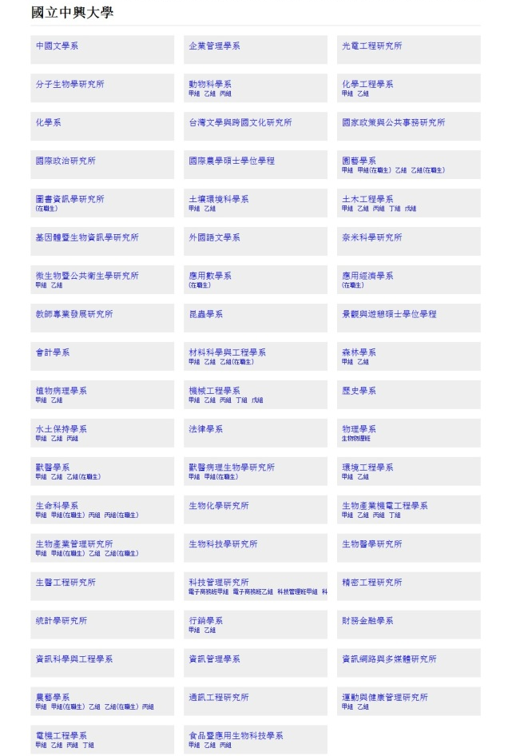

國立中興大學
Notes:
If you search the school name and it will show up all the departments which have offer lists provided by this school.

Slide 6
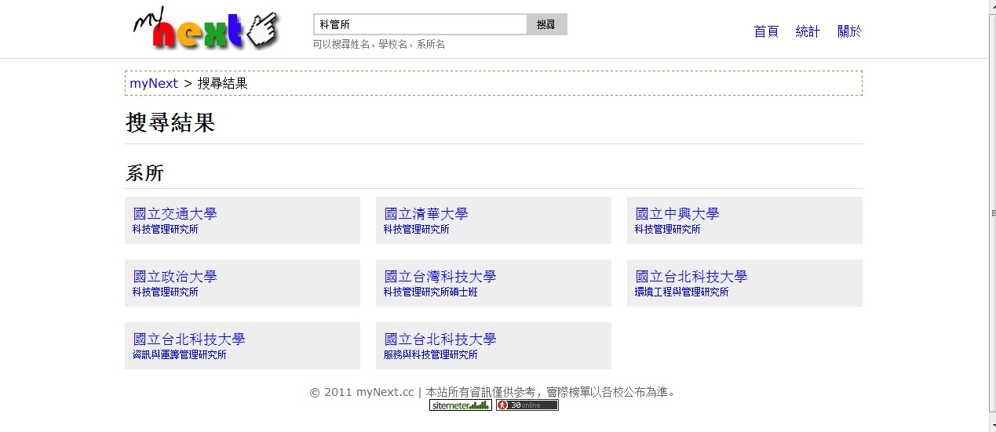
科管所

Slide 7
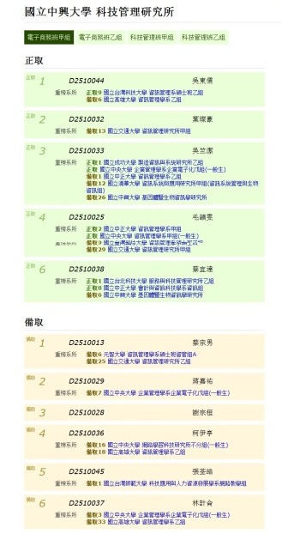
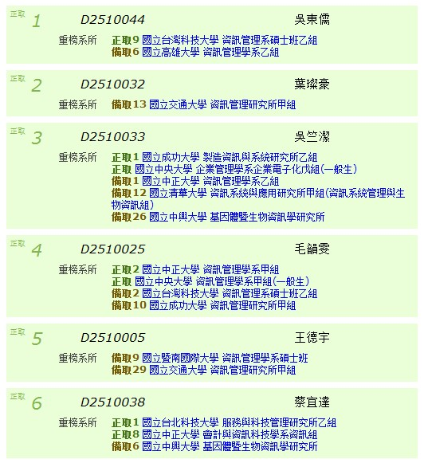
中興大學 科管所

Slide 8
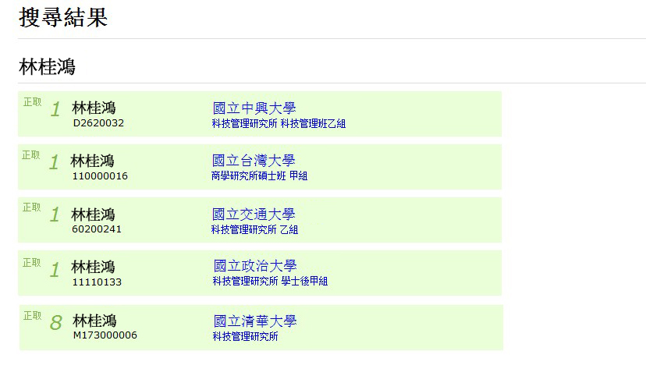
林小明
林小明
林小明
林小明
林小明
林小明

Slide 9
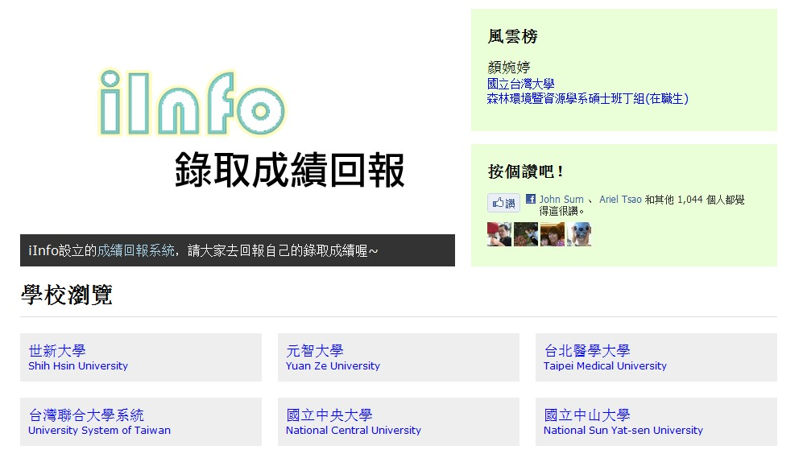
Current States: Service Provided - Fun Statistics

Slide 10
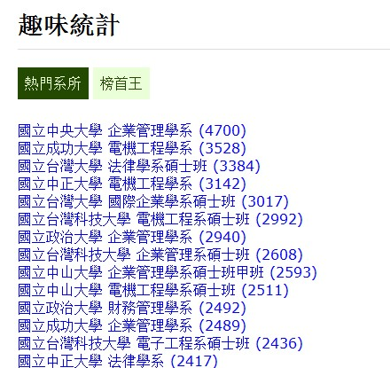
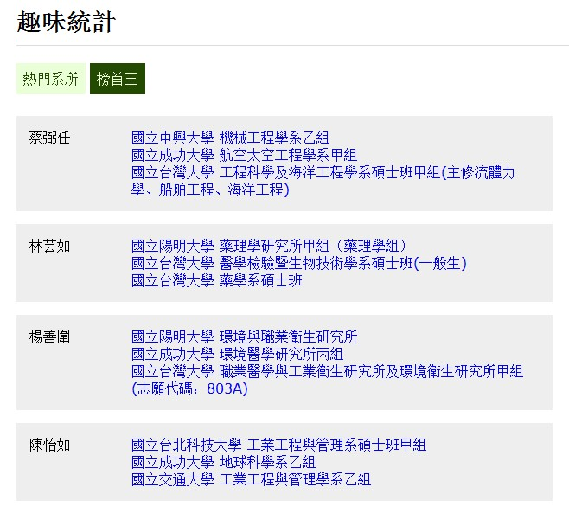
Current States: Service Provided - Fun Statistics

Slide 11

Current States: Business Model
Graduate school program offer lists
Graduate school program offer inquire
Graduate
Schools
examinees
Parents
Teachers
Free
Free
Cost
Items | Price
Development Fee | 30,000
Web Hosting +Domain Name | 900
Maintenance Fee | 41,000
Total: 71,900

Slide 12
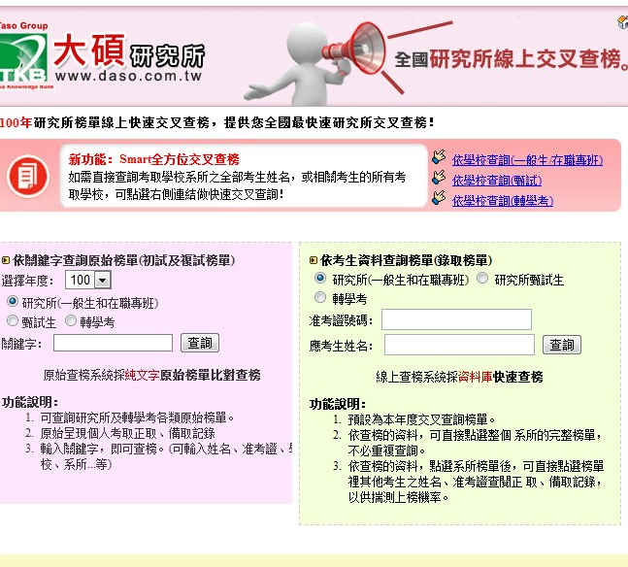
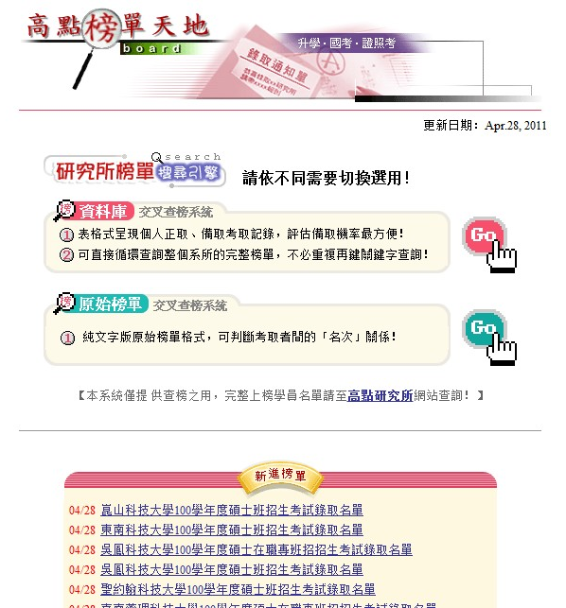
Current States: Competitors

Slide 13
Future
Services Provided
Business Model
Cash Flow
Financial Source
Direction

Slide 14
Future Direction: Service Provided
Graduate school program offer inquire
  Search by school, department, and student names
  multiple offers lists.
Fun Statistics
  The most popular school search
  The candidates who have the most offers
Smart Phone App
  Notified the exams result immediately.
  Follow not just one candidate but more.

Slide 15
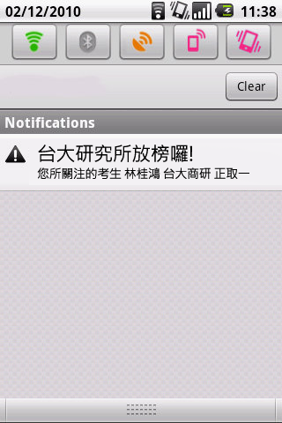
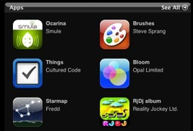
Future Direction: Service Provided - Smart Phone Apps
Download from App Store
您所關注的考生 林小明 台大商研 正取一
NT. 10
NT. 50
政大研究所放榜囉!
您所關注的考生 葉子妹 查無此人
研究所查榜通知系統
NT. 60
NT. 30
NT. 20
NT. 20

Slide 16
Future Direction: Business Model
Graduate
Schools
Examinees
Graduate school program offer lists
Graduate school program offer notification
App Download Channel
Graduate school program offer inquire
Examinees
Parents
Teachers
App
Store
Ad Server
Partner

Slide 17
Future Direction: Cash Flow
Graduate
Schools
Examinees
Graduate school program offer lists
Graduate school program offer notification
Free
57 NT dollars / download
App Download Channel
Graduate school program offer inquire
Examinees
Parents
Teachers
App
Store
Free
Apple store :$2871
Android App store: $725
Commission
AdSense revenue
Banner Space
Ad Server
Partner

Slide 18
Future Direction: Financial Source
Year 1
Revenue |  | Cost
Items | Price | Items | Price
AdSense/one year | 3,359 | MyNext Development Fee | 30,000
Download Paid | 73,159 | Web Hosting +Domain Name | 900
 |  | Maintenance Fee | 8,183
 |  | Programing Fee (Apps) | 20,000
 |  | Registration Fee | 3,596
 |  | Commission (30%) | 21,947
NT Dollars
Total: 76,518
Total: 84,626

Slide 19
Future Direction: Financial Source
Year 2
Revenue |  | Cost
Items | Price | Items | Price
AdSense/one year | 4,367 | Web Hosting +Domain Name | 900
Download Paid | 95,107 | Maintenance Fee | 8,183
 |  | Commission (30%) | 28,532
NT Dollars
Total: 99,474
Total: 37,615

Slide 20
Future Direction: Financial Source
Year 3
Revenue |  | Cost
Items | Price | Items | Price
AdSense/one year | 5,677 | Web Hosting +Domain Name | 900
Download Paid | 123,640 | Maintenance Fee | 8,183
 |  | Commission (30%) | 37,092
NT Dollars
Total: 129,317
Total: 46,175

Slide 21
Future Direction: Financial Source - Profit
NT dollars
Profit
83,142
80,000
61,859
60,000
40,000
20,000
0
-8,108
Time
-20,000
Year 1
Year 2
Year 3

Slide 22
Conclusion
The services MyNext provides today is common on the internet and the number of visits are affected by season. To integrate other related services are necessary for getting profit.
To increase and maintain website traffic by enhancing popularity and public praise can bring more business potential.

Slide 23
Reference
PTT
iCross’s creator
Google AdSense
Hostev: http://hostev.com/
波仕特線上市調網: http://www.pollster.com.tw/Aboutlook/lookview_item.aspx?ms_sn=1276
中華民國統計資訊網: http://www.stat.gov.tw/
ZDNet: http://www.zdnet.com.tw/enterprise/technology/0,2000085680,20137151-2,00.htm
iSoHo: http://www.isoho.com.tw

Slide 24

Thanks for Your Attentions!

Slide 25
appendix

Slide 26
Year 1 Maintenance Fee
(1091(all department)/5(Department can be conducted at same time))*15(the time to import offer list)/60(1 hour)=54.55 hours
2 months takes 54.55 hours
3 months takes 81.825 hours (54.55 *3/2)
1 hour =100 NT dollars
So, 81.825 *100NT dollars =around 8,183

Slide 27
Year 2 Maintenance Fee
(1091(all department)/5(Department can be conducted at same time))*15(the time to import offer list)/60(1 hour)=54.55 hours
2 months takes 54.55 hours
3 months takes 81.825 hours (54.55 *3/2)
1 hour =100 NT dollars
So, 81.825 *100NT dollars =around 8,183

Slide 28
Year 3 Maintenance Fee
(1091(all department)/5(Department can be conducted at same time))*15(the time to import offer list)/60(1 hour)=54.55 hours
2 months takes 54.55 hours
3 months takes 81.825 hours (54.55 *3/2)
1 hour =100 NT dollars
So, 81.825 *100NT dollars =around 8,183

Slide 29
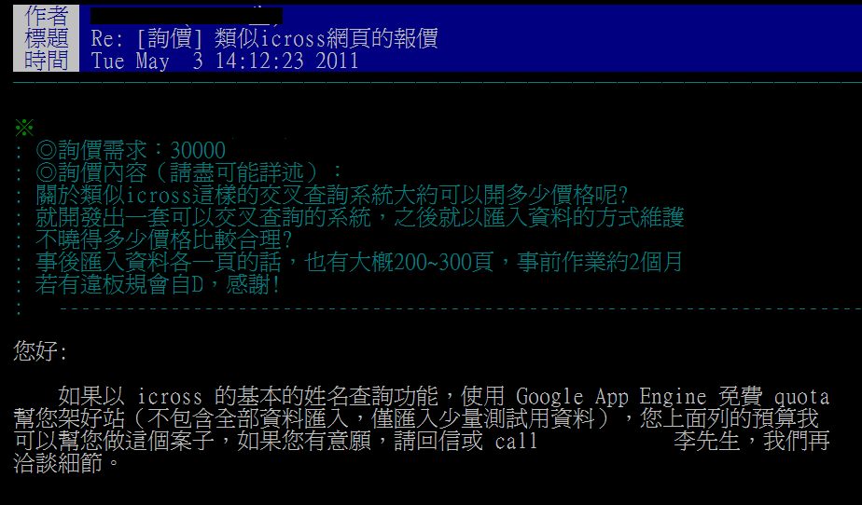
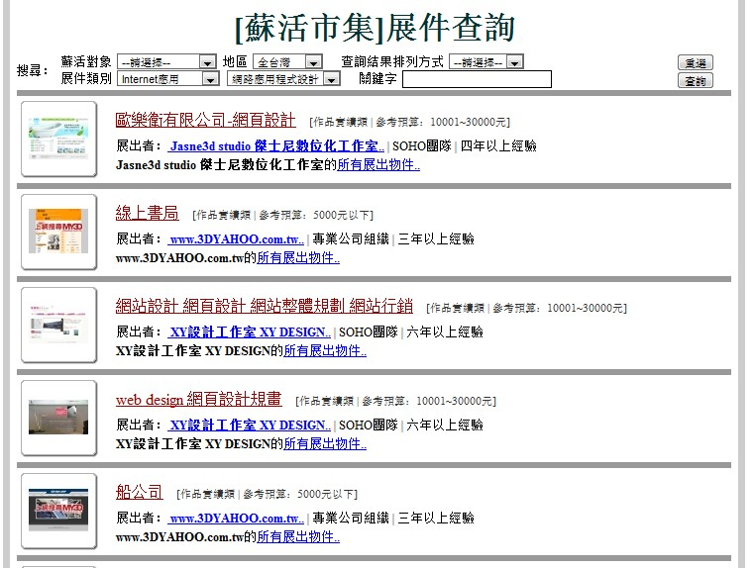
My Next Development fee

Slide 30
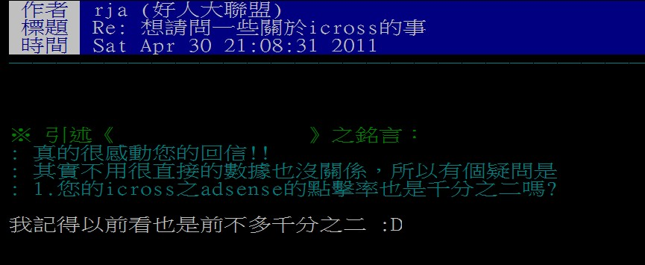
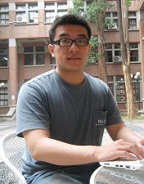
Year 1 Google AdSense Revenue
Months | VIEWS* Average Per Day
1月 | 3000
2月 | 3000
3月 | 70704
4月 | 797660
5月 | 287254
6月 | 210000
7月 | 90000
8月 | 3000
9月 | 1800
10月 | 900
11月 | 600
12月 | 300
total | 1225918
1225918 X 2‰(click-through rate )* X 1.37(dollars per click)
=$3359.01NT
* Reference from iCross creater

Slide 31
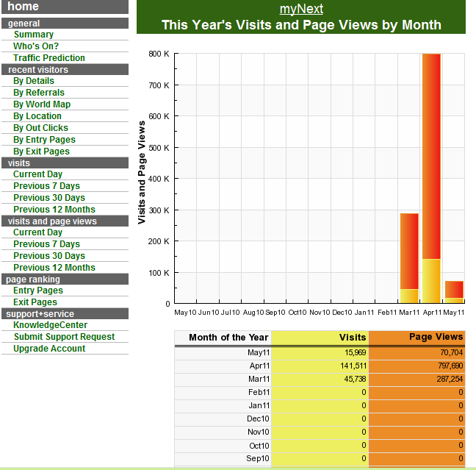

Slide 32
Year 2 Google AdSense Revenue
Year 1
1,225,918 X 2‰(click-through rate )* X 1.37(dollars per click)
=$3,359.01NT
We assume MyNext has gained exposure and increased 30% traffic at Year 2
Year 2
1,225,918 X130%X 2‰(click-through rate )* X 1.37(dollars per click)
=$4,366.72NT

Slide 33
Year 3 Google AdSense Revenue
Year 2
1,593,693 X 2‰(click-through rate )* X 1.37(dollars per click)
=$4,366.72NT
We assume MyNext has gained more exposure and increased 30% traffic from year 2 at Year 3
Year 3
1,593,693 X130%X 2‰(click-through rate )* X 1.37(dollars per click)
=$5,676.74NT

Slide 34
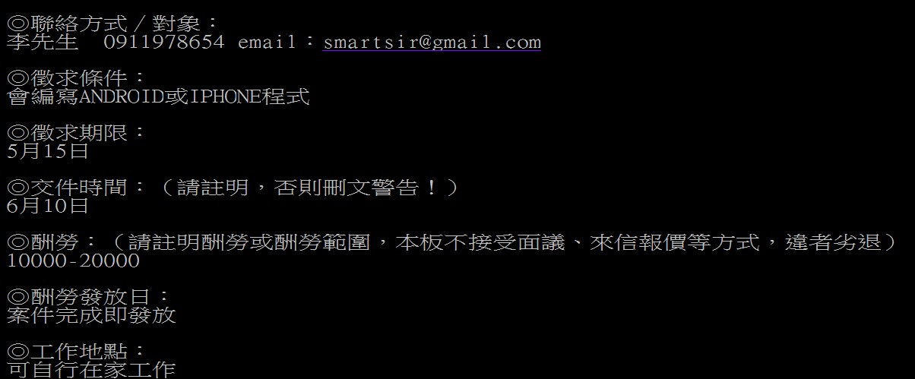
Android Apps Development Fee
Apps Programing Fee: 20,000

Slide 35
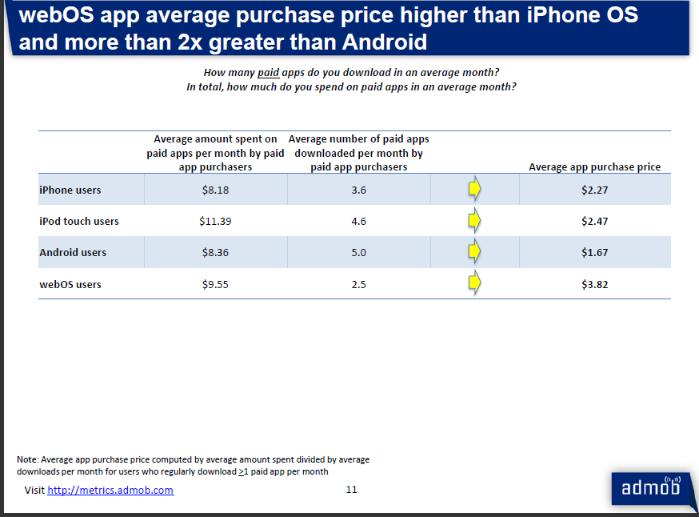
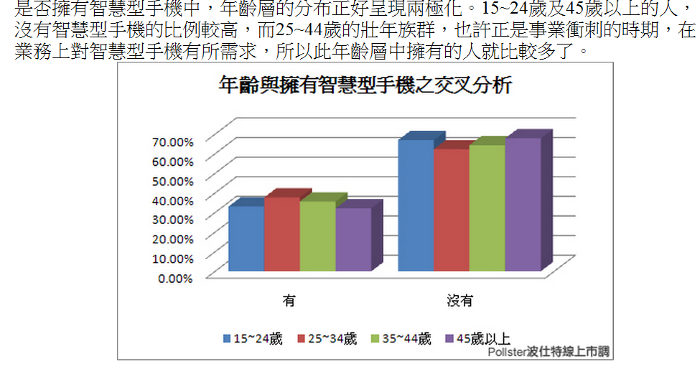
Year 1 App Download Revenue
(213,420/5)=42,684 推估的2010 考研究所學生的數量
42,684*0.3 (這個年齡層擁有智慧手機的佔比)=12,805.8
12,805.8*0.1 (預估此年齡層且有智慧手機的人，會下載的比率)
=1,280.58 會下載app
1,280.58 *[(2.27+1.67)/2*29(平均一個app價格/台幣)]=73,159.53 app收入
波仕特線上市調網: http://www.pollster.com.tw/Aboutlook/lookview_item.aspx?ms_sn=1276
App Usage Survey February 2010 AdMob Mobile Metrics
http://metrics.admob.com/

Slide 36
Year 2 App Download Revenue
Year 1
(213,420/5)=42,684 推估的2010 考研究所學生的數量
42,684*0.3 (這個年齡層擁有智慧手機的佔比)=12,805.8
12,805.8*0.1(預估此年齡層且有智慧手機的人，會下載的比率)
=1,280.58 會下載app
1,280.58 *[(2.27+1.67)/2*29(平均一個app價格/台幣)]=73,159.53 app收入
We assume MyNext has gained more exposure and increased 30% download rate at Year 2
Year 2
(213,420/5)=42,684 推估的2010 考研究所學生的數量
42,684*0.3 (這個年齡層擁有智慧手機的佔比)=12,805.8
12,805.8*0.13 (預估此年齡層且有智慧手機的人，會下載的比率)
=1,664.754 會下載app
1,664.754 *[(2.27+1.67)/2*29(平均一個app價格/台幣)]=95,107.4 app收入

Slide 37
Year 3 App Download Revenue
Year 2
(213,420/5)=42,684 推估的2010 考研究所學生的數量
42,684*0.3 (這個年齡層擁有智慧手機的佔比)=12805.8
12,805.8*0.13 (預估此年齡層且有智慧手機的人，會下載的比率)
=1,664.754 會下載app
1,664.754 *[(2.27+1.67)/2*29(平均一個app價格/台幣)]=95,107.4 app收入
We assume MyNext has gained more exposure and increased 30% download rate at Year 3
Year 3
(213,420/5)=42,684 推估的2010 考研究所學生的數量
42,684*0.3 (這個年齡層擁有智慧手機的佔比)=12805.8
12,805.8*0.169 (預估此年齡層且有智慧手機的人，會下載的比率)
=2,164.18 會下載app
2,164.18 *[(2.27+1.67)/2*29(平均一個app價格/台幣)]=123,639.6 app收入

Slide 38
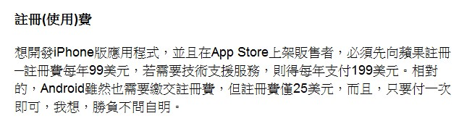
Apps Registration Fee
Reference from: ZDNet

Slide 39
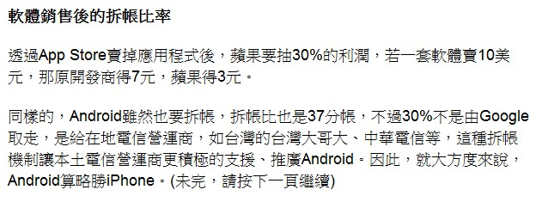
Apps Commission
Reference from: ZDNet

Slide 40
What is CTR?
點擊率 (CTR)
廣告的點擊次數除以按下連結組後出現之廣告網頁的展示次數。
https://www.google.com/adsense/support/bin/answer.py?hl=zh-Hant&answer=32720&ctx=cb&src=cb&cbid=-1v5w730uha3wn&cbrank=2

Slide 41
What is CPM?
每千次展示成本 (CPM)
每千次展示成本 (CPM) 是廣告客戶在使用者檢視其廣告 1,000 次後所需支付的金額，而這也會記錄為一次展示。
https://www.google.com/adsense/support/bin/answer.py?answer=32726

Slide 42
What is Ecpm?
有效每次展示成本 (Ecpm)
  每千次展示的收益，或是有效每次展示成本，是您收到 1000 次展示時可賺取收益的估計值。 例如，如果您從 100 次展示中賺取美金一元，有效每次展示成本為美金 $10.00 元 ($1/100 次展示 X 1000 次展示)。 請注意，這只是估算；您得到的展示次數愈多，估計值就愈精確。
http://www.google.com/adsense/support/bin/answer.py?hl=b5&answer=81567

Slide 43
我是透過點擊次數還是曝光次數賺取收益？
賺取收益的途徑取決於在您網站上顯示的廣告類型。您可以透過單次點擊出價 (CPC) 廣告的有效點擊次數和千次曝光出價 (CPM) 廣告的有效曝光次數而獲得收益。請注意，系統預設會顯示單次點擊出價 (CPC) 廣告，但只有當某個廣告客戶希望透過指定刊登位置在您的網站上投放廣告而進行出價時，才會顯示千次曝光出價 (CPM) 廣告。目前您無法要求在網站上顯示千次曝光出價 (CPM) 廣告，或是將帳戶設定為僅以曝光次數計算款項。
http://www.google.com/support/adsense/bin/answer.py?hl=zh-Hant&answer=59136&ctx=cb

Slide 44
千次曝光出價或單次點擊出價
  透過 AdWords 競價管理 YouTube 刊登位置時，廣告客戶可以根據自己的廣告活動目標，選擇採用單次點擊出價或是千次曝光出價。如果選擇單次點擊出價，只有當使用者按下廣告時，才需要付費。相對地，如果選擇千次曝光出價，每次對使用者顯示廣告時，就必須付費。千次曝光出價會同時考量您的出價到達網頁品質。使用單次點擊出價時，點閱率也會納入考量。
適合單次點擊出價的廣告客戶：
  有既定的投資報酬率目標。
  想要提高網站流量。
  想要使用 AdWords 的轉換最佳化工具。
適合千次曝光出價的廣告客戶：
  想要擴大觸及範圍。
  想要提高廣告的曝光率
http://adwords.google.com/support/aw/bin/answer.py?hl=zh-Hant&answer=173976

Slide 45
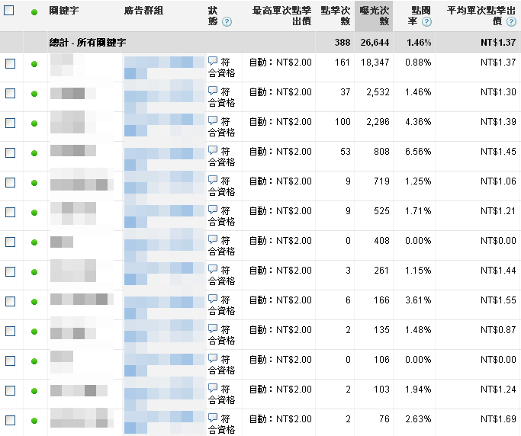
網站的廣告資料
http://www.google.com/support/forum/p/adsense/thread?tid=38c2f8d06c54cedd&hl=zh-TW
http://img69.imageshack.us/img69/566/20100114154830.png

Slide 46
